Slide 1


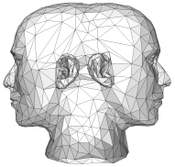
How to do business with German partners
€
€
2007-11-28, Frankfurt
Industrie- und Handelskammer
Offenbach am Main
Frankfurter Straße 90
63067 Offenbach am Main

Slide 2
agenda
You – a business delegation from Vietnam
Germany - a good starting point
Germany - a federated republic
The German ‘Mittelstand’
The hidden champions
How to approach a potential German partner
How to find a German partner
Where to get information from
German exhibitions
Characteristics of German businesses
Corporate culture – what it is about
German cultural stereotypes

Slide 3
You …
are a business delegation from Vietnam
are active in machines and technology sector.
did attend the Messe www.mesago.com/sps on 27th Nov 2007
will visit ZVEI and VDMA
Are mainly looking for suppliers

Slide 4
Germany - a good starting point
Located in the centre of Europe
Coverage of most of Europe within …
  24h by truck,
  30h by train or
  3h by plane
Europe’s largest economy
a strong focus on engineering and manufacturing.
~ 80 million inhabitants,
~ 40 million employees
~ 4 million companies
excellent infrastructure
good skill level
and more …
It is surely not a bad idea to look in Germany for potential partners for setting up a European business.

Slide 5
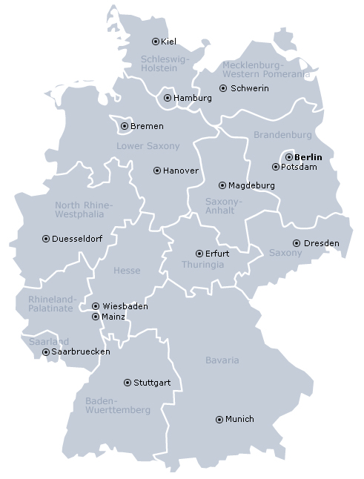
Germany – a federated republic taking the regional diversity successfully into account
May look like a uniform state

Slide 6
















Germany – a federated republic taking the regional diversity successfully into account
May look like a uniform state
Consists in fact of 16 ‘Länder’
  Baden-Wuerttemberg
  Bavaria
  Berlin
  Brandenburg
  Bremen
  Hamburg
  Hessia
  Lower Saxony
  Mecklenburg-Western Pomerania
  North Rhine-Westphalia
  Rhineland-Palatinate
  Saarland
  Saxony
  Saxony-Anhalt
  Schleswig-Holstein
  Thuringia
Each with its own tradition & focus
Competing with each others
Offering different opportunities
Doing independent trade promotion
Having (slightly) different cultures

Slide 7
The German Mittelstand the backbone of Germanys economy – (often hidden) champions
Small & medium sized (SME) companies
A typical German phenomenon.
Definitions according to “Institut für Mittelstandsforschung”, Bonn http://www.ifm-bonn.org.
  1 > 50 million Euro turnaround
  10 > 499 employees.
  Cross industry sector
numbers
  3,3 Million SME’s, freelancer & self-employed.
  > 85% of all German companies
  ~ 40% of all German companies turnaround
  employ ~70% (~20 million) of all German employees.
typically
  owner-managed.
  strong Identification of management with the company.
sources
  http://www.bmwa.bund.de
  http://www.ifm-bonn.org
  http://de.wikipedia.org
It is often worth to look beyond the large corporations
Source: adapted from Faixet al. 2006

Slide 8

The hidden champions the most successful companies are nearly invisible.
The Germans are export champions
It’s not due to the large corporations.
But by a group of lesser know companies who are world champions is a small market segment.
Operating since many years successfully but invisible.
They tend to avoid publicity.
In Germany alone there are ~ 1200.
Innovation is their most distinctive element.
Nearly all of them reached world championship.
Because they once started as pioneers.
… in technology or market approach.
Their corporate culture differs considerably from large corporations

Slide 9
The Hidden Champions
Germanys top performers are often not seen at 1st sight
are small or medium sized companies.
rule the world market often by > 50% market share.
often provide ‘invisible’ or unspectacular products.
show a remarkable ability to survive under changing conditions.
have a substantial export quote.
contribute significantly to Germanys trade balance.
are truly global competitors.
are mostly family owned and managed.
are successful but not miracle companies.
reside often in remote places.
are led by a strong, sometimes ‘peculiar’ corporate culture.
It might be worth to ‘dig a bit deeper’ to find the best partner.

Slide 10
Hidden champions in 2007 some examples of small or medium sized world champions
Baader
  Fish processing machines
Barth
  Hop and Hop products
Schwan-Stabilo
  Pencils, cosmetics
Gerriets
  Theatre curtains and stage equipment
3B Scientific
  Anatomic teaching aids
Arnold & Richter
  Professional cameras
Schachtler
  Camera tripods
Tetra
  Ornamental fish feed
Wirtgen
  Recycling of road pavements
Stihl
  Chain saws
Webasto
  Car sun roofs and car heatings
Würth
  Screw, bolts & assembly
In 2007 ~ 1200 German companies are considered hidden champions.

Slide 11
How to approach a potential German partner straight to the point but not without courtesy
Collect information
  Various information sources at a confusing number are to be used.
Screen for potential partners
  Make your checklist for a quick triage
Make an initial contact
  1st impression is most important
  Exhibition, fairs & tradeshows offer best opportunities
  Have a ‘sticky’ message and supporting documents at hand.
Assess your potential partner
  The company - is it the right company by location, size, portfolio?
  The product - if you look for products, would it be the right choice?
  The process – is the experienced behaviour promising.
Keep in touch
  Continuous communication is key for success
  In person meeting are essential for the start
  Use modern communication (email, chat, VoIP, video-conferencing, …)
  Set up a regular communication agenda (jour fixe, meeting minutes, …)
It might be a lot of work – but it’s not rocket science to find a partner.

Slide 12

How to find a German partner
How to find suppliers, technology transfer, investment partners
There are lots of information sources …
  Association of German Chambers of Industry and Commerce (DIHK) www.dihk.de
  Federal Ministry of Economics and Technology (BMWi) www.bmwi.de
  Federation of German Industries (BDI) www.bdi-online.de
  Organization for Economic Cooperation and Development www.oecd.org
  Institut für Mittelstandsforschung Bonn: http://www.ifm-bonn.org/
  Invest in Germany GmbH: http://www.invest-in-germany.de/en/
  German business portal: http://www.german-business-portal.info/
  Regional sources (see next slides)
There is a confusing amount of information available.
But own research is required anyway.

Slide 13
Where to get information from
Regional business development agencies
Source: business guide to Germany

Slide 14
Where to get information from
Regional business development agencies
Source: business guide to Germany

Slide 15

ZVEI
Zentralverband Elektrotechnik- und Elektronikindustrie e.V.
What it is …
  German Electrical and Electronic Manufacturers Association,
  represents its members‘ economic, technological and environmental policy interests.
  provides specific information about the economic, technical and regulatory framework conditions of the electrical industry in Germany.
Its Mission …
  improve its member companies international competitiveness.
  safeguard common interests,
  exchange experience,
  provide information
What it does …
  promotes the development and use of innovative technologies
  proposes research, technological, environmental protection, educational and scientific policy.
  supports market-orientated European and international standards-making activities.
How it works …
  maintaining close contacts with political quarters and public administrations
  exchanging experience the association's internal and views
  tailoring information to the electrical and electronic industry's specific needs.
  providing extensive information about market- and competition-related developments
Its bodies …
  General Assembly
  Honorary Board
  Presidental Committee
  General Executive Management
Contact …
  ZVEI - Zentralverband Elektrotechnik- und Elektronikindustrie e.V.
  Stresemannallee 19
  60596 Frankfurt am Main
  Postfach 70 12 61
  60591 Frankfurt am Main
  Fon +(49)69 6302-0
  Fax +(49)69 6302-317
  Mail zvei@zvei.org
  https://www.zvei.org/

Slide 16

VDMA
Verband Deutscher Maschinen- und Anlagenbau
Verband Deutscher Maschinen- und Anlagenbau e.V.
Lyoner Strasse 18, 60528 Frankfurt/Main
Postfach 71 08 64, 60498 Frankfurt/Main
Telefon +49 69 6603 0
Fax +49 69 6603-1511
Kommunikation@vdma.org http://www.vdma.org
What it is …
  German Engineering Federation
  Europe's largest engineering industry network.
  one of the largest and most important industrial associations in Europe.
  represents 3,000 small/medium size member companies in the engineering industry,
  Accounts for sales of ~ € 143 billion and 865,000 employees.
  covers the entire process chain.
  reflects the varied customer-supplier relations all along the value adding chain.
The mission …
  voice its members views …
    Labour market and pay policy / deregulation
    Education policy / attracting new generations
    Tax policy
    Research policy / technology policy
    Corporate financing
    Trade policy
    Environment and energy policy
    Trade fairs/trade fair policy
What is does …
  Networks > 20,000 decision-makers and specialists from 3,000 member companies, 400 VDMA-experts.
  covers a broad spectrum
  orientates towards the needs of the member companies.
  Focuses on ..
    Market, statistics and the economy
    Foreign business and exports
    Law, taxes and wages
    Management and information systems
    Marketing and customer service
    E-Business and industry portals
    Research and technical codes
    Education and recruitment
    Technology and the environment.
    Insurance services,
    target group-specific publications
    seminars.
How it works…
  Connecting competitors, customers, suppliers or cooperation partners for their mutual benefit.
  providing a platform here for the members.
  connecting managers and directors, department heads and specialists from the engineering industry.
  organising regional associations, specialist associations, research groups, committees and working groups.
The products and services of the engineering industry are highly regarded worldwide.
~ 2/3 of German production is exported.

Slide 17
German exhibitions an important way to contact German partners
Germany is the world leader in international trade fairs:
  ~ 1/3 of the main international trade fairs
  4 of the 5 largest trade fair grounds in the world (Hanover, Frankfurt, Cologne and Düsseldorf).
  yearly ~ 150 international trade fairs and exhibitions,
  > 160,000 exhibitors and
  9 - 10 million visitors. (AUMA).
German trade fairs are international:
  Around half the exhibitors come from abroad, a third of those from countries outside Europe.
  Around 20 percent of visitors come from abroad.
The trade fairs ..
Frankfurt:
  International Motor Show IAA in
  In the process industry, ACHEMA, which is held every three years in, is now one of the largest specialist trade fairs in the world.
  The Frankfurt book fair has become the largest in the world, the
Hanover:
  computer and telecommunications trade fair CeBIT in.
Düsseldorf:
  The Drupa trade fair (print media) in also attracts half a million visitors every five years.
Cologne:
  photography trade fair Photokina, the most well-known trade fairs in,
  the furniture trade fair, and
  the food and beverage trade fair Anuga.
Berlin:
  leads the world with its international consumer electronics trade fair IFA,
  the international tourism exhibition ITB, and
  the International Green Week.
  The international aerospace exhibition (ILA)
  Berlin-Brandenburg:
    captivates visitors every two years.
Hamburg:
  Shipping experts are drawn to the largest shipbuilding trade fair in the world, SMM, in every two years, and
  the Hanseboot boat show every year.
Munich:
  international trade fair for small and medium-sized enterprises I.H.M.,
  the international trade fair for information technology and communication technology Systems,
  the international building machinery trade fair BAUMA, and
  the leading European trade fair for logistics, transport logistic.
Nürnberg:
  The Nürnberg trade fair site is most famous for its toy trade fair.
Leipzig:
  Leipzig book fair is also attracting more visitors each year.
Contact: AUMA
  The major trade fair locations are members of the Association of the German Trade Fair Industry.
German businesses are used to make decisions at trade fairs – a good chance for a 1st contact.

Slide 18
Characteristics of German businesses acting slowly but used to make decisions at trade fairs
German companies may seem to act slowly
Decisions are mostly prepared carefully
  There are often several departments involved in a major business decision.
Germany is highly regulated
  lots of regulations have to be checked before action.
Working overtime often is restricted
  especially in large companies with a workers council.
School holiday seasons offer specific obstacles
  Sometimes it is hard to find a peer for your communication
Germanys top performers often reside in remote places
  Germanys economy is decentralised by nature
  Looking-up several potential partners may cause considerable effort.
Exhibitions, fairs & tradeshows are of special value in Germany.
  Here you can meet many otherwise scattered partners at one place.
  Sometime the entire management is on the fair anyway.
  Germans are used to make decisions on trade shows.
If you follow an agreed procedure an stay patient – it might be worth the effort.

Slide 19
Corporate culture – what it is about several layers form what we call a culture
company
mankind
  Family
  war & peace
  trade
  religion
  civilisation
company.
  determination by founder, owner, long term management
City
  May add specifics, e.g. Neuss<> Düsseldorf
region:
  Each German region has its own history
  Consider the Bavaria vs. Prussia conflict
Nation - Germany
  constitution
  history
  language
continent Europe
  Christian background (10 commandments)
  French revolution
  Labour movement
  Reformation
city
region
nation
continent
mankind
Cultural differences occur not only between the nation or continents even within you will face a huge cultural diversity

Slide 20
Corporate culture – our common heritage we all share the same evolution-biological roots.
company
In successful groups the strongest individual leads
Performance con only be delivered if I makes ‘fun’.
The better performer advances by aggression.
By commitment to the group the inferior is held within the group.
city
region
nation
continent
mankind
Evolutionary biology
(successful leadership or cooperation in a dynamic environment
works along our instincts not against them!)
The most important basic group behaviour is in common for all peoples.

Slide 21
German cultural stereotypes good to know – but be prepared for surprises
Positive characteristics:
☺
Hard Working
Exact
Punctual
Orderly
Quality Focused
Trustworthy
Committed
Negative characteristics:
☹
Perfectionists
Stubborn
Inflexible
Obsessed with work
Serious
Know-it-alls
Grouchy
Unfriendly
Cold and Reserved
But there is a huge diversity within Germany.
And on the other hand a global business behaviour is evolving.
Source: Angelika Rahmer
Notes:
Every culture has ist own cultural standards which generate „stereotypes“. Before pointing out some of them which are associated with „Germany“ oder „German“. I would now like you to ask if you have some stereotypes in mind, which are „typical german“ (both good ones and bad ones)
1. Beispiele der Teilnehmer
2. Beispiele Chart
What I wanted to show you is:

Slide 22
Communication patterns
Something, you should know
Direct, targeted, low-context communication
Importance of time-orientation (‚Time is money‘)
Expressive body language and sound intensity
Serious or unfriendly face
Consecutive communication attitude (one after the other, no interruptions while speaking)
Separation between private and official
Chance to say „no“ without losing face
Source: Angelika Rahmer
Notes:
Direct (low-context)-communication: what means, the message is functional and targeted.
Time-orientation means the importance of exploiting time (hardly said: every hour, nearly minute has to filled out usefully (in official life). Germans know and live the sayings: „Time is money“ or „If you rest you rust“. To be in time to be punctual also belongs to the time-orientation. Germans expect themselves and you to be in time. 9 o‘clock menas 9 o‘clock or at least 5-10 min. later
Expressive body language and sound intensity are typical when the conversation comes to an important point, to an result, or when it enters a complicated topic, f.e. disagreement during negogiations.
It might be even worse: Serious or unfriendly face: You will encounter Germans, who are not showing a friendly face, they are even serious and grouchy. But please try not to get insecured by this. This is part of the german also allows to see someone‘s mood. Germans sometimes keep the bad weather on their face.
Consecutive communication: interrupting s‘one while he is speaking is considered as an inpolite attitude.
Germans don‘t mix up official and private life in particular during the first meetings. I will tell you later what this means in concrete.
German culture and mentality offers the chance to say „No“. This is quite normal in business life. Please note: German might reject an idea, a proposal or a topic, but not the person or the business partner who stands behind it. This refers to the fact that Germans are more issue-related, whreas in eatsren societies the „trust buildung“ comes first.
Let‘s get more concrete now. Ladies and Gentlemen and let‘s see, how these patterns are essential in a real situation:

Slide 23
Germans and their forthright mentality
Greetings („How are you?“)
  (sometimes) demanding a truthful answer
Commands („Please call me!“)
  expecting a call within a few days
Invitations („Please visit us the next time when you are here“)
  you are invited: you should accept them
  you invite: the German will come!
Promises („I will send you the required addresses in the next few days!“)
  you should do so!
Punctuality („We will meet tomorrow at 11 a.m.!“)
  means 11 a.m. or minimum 5 - 10 min. later!
A „yes“ means yes, a „no“ means no
You may be sure, that Germans mean exactly what they say!
Source: Angelika Rahmer
Notes:
After all you have heard until now and as to your own experiences you might have the impression, my dear Ladies and Gentlemen, that Germans have a real forthright mentality
Ablesen!!

Slide 24
The end ...
Thank you very much for your attention!
In case of questions:
horst.walther@si-g.com,
phone: +49 40 32005 439
skype: HoWa01
VoIP: +40 40 22611326
mobile: +49 171 2145502
http://www.si-g.com/

Slide 25

questions - comments - suggestions?

Slide 26
Information sources
Association of German Chambers of Industry and Commerce (DIHK) www.dihk.de
AUMA, Association of the German Trade Fair Industry, http://www.auma-messen.de/_pages/start_e.aspx
Federal Ministry of Economics and Technology (BMWi) www.bmwi.de
Federation of German Industries (BDI) www.bdi-online.de
German business portal: http://www.german-business-portal.info/
Institut für Mittelstandsforschung (IfM): http://www.ifm-bonn.org/
InWEnt – Internationale Weiterbildung und Entwicklung gGmbH
Capacity Building International, Germany, http://www.inwent.org/index.en.shtml
Invest in Germany GmbH, http://www.invest-in-germany.de/en/
Organization for Economic Cooperation and Development (OECD), www.oecd.org
Verband Deutscher Maschinen- und Anlagenbau (VDMA), http://www.vdma.org
Zentralverband Elektrotechnik- und Elektronikindustrie e.V. (ZVEI), https://www.zvei.org/

Slide 27
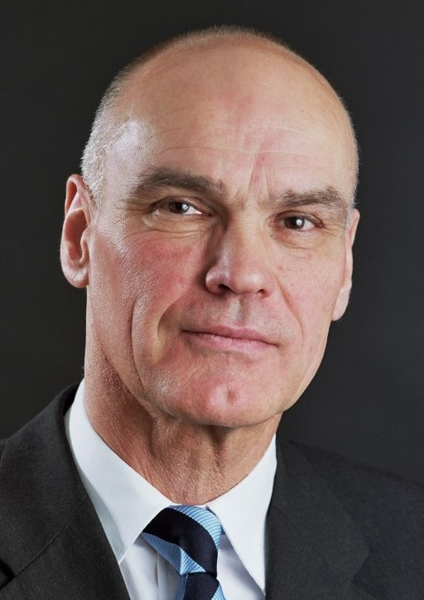
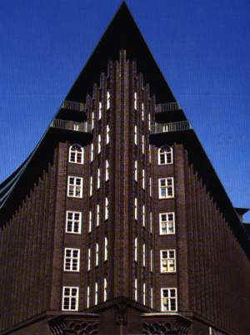
Dr. Horst Walther
SiG Software Integration GmbH – http://www.si-g.com
Horst.Walther@Si-G.com
http://www.si-g.com/
I am an international management consultant from Germany.
My professional portfolio spans due diligence assessment, strategy development, international project management and interim management.
My focus is on the competitive use of information technology in insurance companies.
During several years I developed a special expertise in Identity Management.

Slide 28

Attention
Backup slides
(not for printed or electronic handouts)

Slide 29
Die heimlichen Gewinner
Erfolgsfaktoren ihres Sieges
Unternehmensziele
  aktiv, aggressiv, optimistisch
  konzentriert auf die Kernkompetenzen
  auf gemeinsame Ziele und Werte eingeschworen
Der Markt
  eng definiert
  hoch spezialisiert bearbeitet
  Sortimente tief nicht breit
  hoher Spezialisierungsgrad
  unerreichte Perfektion
  ihr Markt ist die Welt
Die Kunden
  Direkte Kundenkontakte
  Langfristige Geschäftsbeziehungen
  Kundenbindung wichtiger als kurzfristiger Gewinn
Innovation
  2 Quellen: Kunde und Spezialisierung
  Konzentration auf ein Spezialgebiet
  Bestimmen die „Schlagzahl“ mit immer neuen Innovationen
Der Wettbewerb
  Suchen aktiv die leistungssteigernde Konfrontation mit den stärksten Wettbewerbern.
  Immer in mindestens einem Punkt besser als der Wettbewerb.
  Wettbewerb über Service und Qualität.
Die Partner
  Kernkompetenzen
  Langfristige Beziehungen
  gegenseitiges Vertrauen
  Folgen den Kunden weltweit

Slide 30
Die heimlichen Gewinner
Erfolgsfaktoren ihres Sieges
Das Team
  Sehr starke und eigenwillige Unternehmenskulturen.
  Hohe Identifikation mit den Zielen und Werten des Unternehmens.
  Stammbelegschaft: geringe Fluktuation, niedriger Krankenstand
  Wenig Reibungsverluste.
  „An den Wochenende haben wir unsere Konkurrenten geschlagen.“
  Schlüsselfaktor Mitarbeiterqualifikation
  Hohe Investitionen in Weiterbildung.
  Lernen am Arbeitsplatz wichtiger als formale Programme.
  Sehr sorgfältige Personalauswahl.
  Test neuer Mitarbeiter am Arbeitsplatz.
  Neue bleiben entweder lange oder gehen schnell wieder.
Die Führungskräfte
  Unermüdliche Kraft und Energie
  Klare Schwerpunkte
  Voll auf das Geschäft konzentriert
Führungsstil ist:
  autoritär in den Werten, Zielen, Kernkompetenzen
  partizipativ und Freiräume lassend bei den Einzelheiten der Durchführung.
  Arbeit nach dem Flow-Prinzip.
  Dank und Anerkennung nehmen breiten Raum ein.
  Eine „eingeschworene Gemeinschaft“
  Unternehmen und Person des Gründers immer als Einheit.

