Slide 1
Successful IAM Implementation Strategies
Birds-of-a-Feather II
2nd European Identity Conference
2008-04-23, 16:00-17:00
Forum am Deutschen Museum
Museumsinsel 1 • 80538 München Phone: +49 89211 25170 • Fax: +49 89211 25165 Web: http://www.forumamdeutschenmuseum.de
Dr. Horst Walther, Version 2008-04-21

Slide 2
Birds-of-a-feather
Dr. Horst Walther, Kuppinger Cole + Partner
Paul Heiden, BHOLD COMPANY BV
how to identify business drivers
how to meet business requirements
why IAM-projects fail
why IAM projects succeed
determine your strategy
This Birds-of-a-feather will be supervised by Paul Heiden, CEO BHOLD Company.
Paul will introduce the subject and set the scene with a short presentation.
Goal is to share experiences and lessons-learnt and make participants help each other to determine the outlines of an implementation strategy that matches your organization’s requirements.

Slide 3
Caveats - why IAM-Projects fail 7+1 reasons and more to expect.
Cross-company character IAM-Projects touch multiple corporate functions
differing Process maturity no islands of order in an ocean of chaos
wrong Project scope An implementation project cannot reorganise the corporation.
Adverse effects of the market consolidation acquired components don’t necessarily combine to Suites
Non-availability of domain knowledge specialists persons with business domain knowledge are rare creatures
To deep vertical integration don’t try to reinvent the wheel
Technical risks – they still exist Technology often is more of marketing than reality
Sub-optimal assignment of responsibilities corporate organisation needs a Business Owner

Slide 4
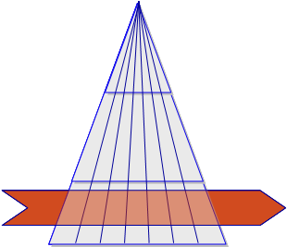
Cross-company character IAM-Projects touch multiple corporate functions
Complexity factors
Identity-Management Processes are typically cross-company.
There are multiple Stakeholders from different corporate levels involved in a project.
3 to 5 mal times higher Communication complexity compared to „normal“ IT-projects.
Typical Change Management Process
actions
Strengthen the project management!
Add an extra reserve for communication!
Insist on a power sponsor for your project!

Slide 5
differing Process maturity no islands of order in an ocean of chaos
Complexity factors
At higher levels of maturity of the management processes (e.g. according to CMMi) the introduction of IAM- processes, -rules, -roles, -policies becomes easier.
You can’t implement mature IAM-processes in a low maturity process environment.
The top-down definition of roles needs defined processes.
actions
Only launch IAM-projects relying on a maturity level as implemented in the environment.
Occasionally just say „no”!

Slide 6
wrong Project scope An implementation project cannot reorganise the corporation.
Complexity factors
Implementation project will have a hard job when having to reorganise the corporation first.
Process- and Role-Definitions require their own Definition projects before or in parallel to the Implementation.
actions
Define own projects for the Definition of Processes and Roles before or in parallel to the Implementation.

Slide 7
Adverse effects of the market consolidation acquired components don’t necessarily combine to Suites
Complexity factors
Mergers & Acquisitions often lead to less compatible Product collections.
The software of acquired companies is often not supported sufficiently.
It may take a long while, until components fit together as promised.
actions
Only a Pilot installation under real world conditions leads to the necessary evidence for a product selection.

Slide 8
Non-availability of domain specialists persons with business domain knowledge are rare creatures
Complexity factors
The availability of specialists with domain knowledge often turns out to be the bottle neck in role- und process definitions.
Their involvement is essential for the requirements definition and the QA.
Waiting times (for specialists) are driving the overall effort.
While in projects they tend to disappear.
actions
Assign the project responsibility to the business departments.
Think of splitting projects to business definition and an implementation part.

Slide 9
To deep vertical integration don’t try to reinvent the wheel
Complexity factors
Only a fraction of the overall IAM-Processes is really enterprise specific.
The adoption of processes and / or Roles from generic Models may speed up projects.
It may … projects always to start with a blank sheet of paper.
actions
Ask your integration partner or consultant for consolidated models containing his experience.
Participate in Standardisation initiatives (like GenericIAM.org).

Slide 10
Technical risks – they still exist Technology often is more of marketing than reality
Complexity factors
IAM-SW-Suites are complex and often not easy to handle.
Without implementation experience in exactly the required environment risk of failure is high.
„minor“ changes of the version number sometimes cover oft complete new developments.
The support Matrix of environment components vs. versions often is only sparsely populated.
Forced replacement of infrastructure components leads to higher effort.
actions
Always test selected software in a pilot run before deployment.
Only choose integration partners with true product experience.

Slide 11
Sub-optimal assignment of responsibilities corporate organisation needs a Business Owner
Complexity factors
Identity Management is a management task.
Identity Management means organising the enterprise.
HR could be the natural owner – but often refuses.
IT ahs the implementation capabilities but is not mandated to change the organisation.
On the business side methodological and technical knowledge is lacking.
actions
Shift the responsibility to the business side.
Create a new cross functional function (group) for the doing.

Slide 12
Sub-optimal assignment of responsibilities corporate organisation needs a Business Owner
Complexity factors
Identity Management is a management task.
Identity Management means organising the enterprise.
HR could be the natural owner – but often refuses.
IT ahs the implementation capabilities but is not mandated to change the organisation.
On the business side methodological and technical knowledge is lacking.
actions
Shift the responsibility to the business side.
Create a new cross functional function (group) for the doing.

Slide 13
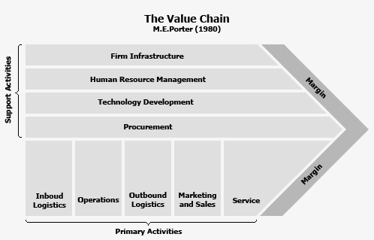
Responsibility Who should be responsible for the Identity Management?
HR
has a natural relationship to Persons / person data.
Often far from being business minded
HR acts not really “real time”.
IT
Technical implementation skills available
not mandated for organisational changes.
Organisation is not Technology.
new function
Still without examples
Must be responsible for Identities, Roles & processes
Needs business organisational and technical skills.
Must be mandated for organisational changes.
Chance for a tailored design
Business
Tasks and responsibility match perfectly.
Don’t act enterprise wide
Special skills are missing.

Slide 14
Questions - comments – suggestions?

Slide 15
Attention Appendix
From here the notorious back-up slides follow ...

