Slide 1


Cultural limitations to quality
How and corporate culture determines the achievable target quality
- or –
How much quality does our corporate culture permit?
Dr. Horst Walther, Business Advisor Operational Risk Management
Member of the VCB & Company LLP, London,

Slide 2
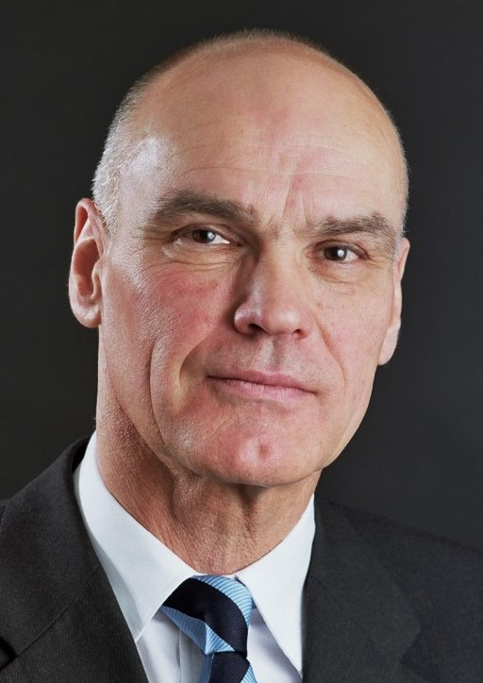
Dr. Horst Walther is a business advisor
He focuses on…
  due diligence, audits and potential analysis of the corporate IT,
  The development and verification of IT-Strategies and
  Change Management in the area of information technology.
After studying chemistry, computer science, oriental studies and economics, he worked in various companies in the software development and software for quality management.
Inspired by his formative years in Carinthia, it is concerned with the factors for organization of sustainably successful companies.
Horst Walther is founder of the Corporate Culture Institute in Vienna.

Slide 3
summary
Necessary changes to corporate processes increasingly run into limitations that are set by the corporate culture..
Even in a business’ daily operations these factors limit the goals to be set, such as the achievable target quality of processes and products.
In this paper the concept of corporate culture is defined, the interaction between corporate culture and quality of process outputs are explained and hints are given how to influence it.
The lecture notes close, giving direction for meaningful strategic decisions and some practical measure.

Slide 4
agenda
motivation
Why do we have to deal with corporate culture?
history
Which work has been done on this topic to today?
definition
Was is corporate culture after all?
origin
Where does corporate culture come from?
diagnosis
How to diagnose corporate culture?
design
How can we create a quality culture?
examples
The „hidden champions“ - success through corporate culture
outlook
what is left to be done?

Slide 5
Motivation – 1. Customer relationship
Why do we have to deal with corporate culture?
The competition in most industries is determined by the increasing globalization and is gaining in intensity.
Many of the competing products and services are in competition have become increasingly similar.
Quality differences can often only be experienced on the basis of "faith factors" (Zeithaml, 1981).
Thus resulting in the personal contact between employees and customers, as an increasingly important function.
Success in business is increasingly dependent on good relations between employees and customers.
So it also depends on good relation processes between management and staff.

Slide 6
Motivation
Why do we have to deal with corporate culture?
Increasing pressure on innovation and cost caused by competition...
  requires an effective and efficient use of available power potential and resources from businesses and organizations .
The resulting increased performance pressure ...
  demands a special attention for the development and maintenance of personal commitment from employees.
The corporate culture ...
  thus moves increasingly into the focus of economic and general social interests.
The corporate culture and thus the quality of work ...
  is more often attributed to be able to improve process and product quality, the competitiveness of companies and the satisfaction of all stakeholders.

Slide 7

Motivation – 1. process maturity
Why is CMMi level 2 so high?
The employees must adopt the common values ​​of "discipline" and "consequence". This is means a cultural change.*
Why is
CMMi level 2
so high?
5 optimizing
4 quantitatively managed
3 defined
2 managed
1 initial
* Ralf Kneuper, CMMI, dpunkt Verlag

Slide 8
Motivation – 2. the big reluctance
Only 13 % of all employees are committed*
Only 13 % of all employees confirm, that they are really committed to their work.
Demotivated employees according to a survey of the consulting firm Gallup cause a yearly economic loss of 220 billion Euro in Germany .
The levels of Motivation are …
Commitment
Internalised Motivation
Enrolment
Awarded Motivation
Compliance
Forced Motivation
Can top quality achieved through „obedience“?
* neuer Gallup-Engagement-Index 2008

Slide 9
History
Which work has been done on this topic to today?
Taylor's scientific management began the systematic treatment of quality .
Early the importance of culture as a driver
has been assumed.
TQM (Deming and Ishikawa)
made it an essential ingredient.
The move from customer focus to
product focus shifted it to the
center.
Its importance is
accepted today.
But the “how to”
still causes
headaches.

Slide 10
History
EFQM Excellence Model®
European Foundation for Quality Management (EFQM)

Slide 11
History
EFQM Excellence Model®
Culture
European Foundation for Quality Management (EFQM)

Slide 12

Definition
What is corporate culture after all?
“An organization’s widely shared values, symbols, behaviours, and assumptions”
Goffee & Jones, The Character of a Corporation (2003)
“a pattern of basic group assumptions that has worked well enough to be considered valid, and, therefore, is taught to new members as the correct way to perceive, think, and feel”.
“Stated values” vs. “Tacit assumptions”
Edgar H. Schein, Organizational Culture and Leadership (2004)
Culture = the way we do things around here
...(Ouchi, 1979)

Slide 13
Definition
What is corporate culture after all?
The iceberg metaphor puts emphasis the weight of the invisible part of the corporate culture.
observable symbols, ceremonies, stories, slogans, behaviours, dress, physical settings, …
visible
invisible
Underlying Values, Assumptions, Beliefs, Attitudes, Feelings

Slide 14
Definition
How do we deal with each others?
superior
winning
attitude
competition
partner
leadership
cooperation
politics
mobbing<
me
colleague
industry sector
knowledge
service
corporation
sourcing
vertical
integration
leadership
customer
supplier
subordinate
internal orientation
external orientation

Slide 15
origin & impact
How is corporate culture created?
Its core are a corporations guiding values, it’s ethics.
The corporate culture …
  influences a corporations action directly and often unconsciously.
  resists to direct engineering.
  is confirmed or changed by all decisions or actions.
Our actions offspring from several sources:
  founder, market forces, cultural embedding, …
actions
actions
short term
no direct engineering possible
has impact on all actions – often unconsciously
--- influence ---
x
values
values
medium term

Slide 16
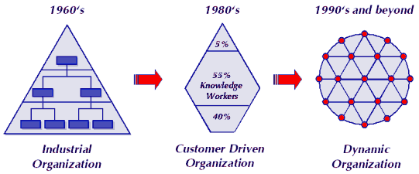
origin - corporate culture & market
How efficient, how flexible should the corporation be?
high
2
4
specialisation
1
3
low
low
market dynamics
high
specialisation versus flexibility

Slide 17
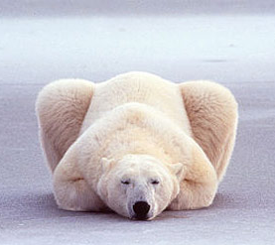

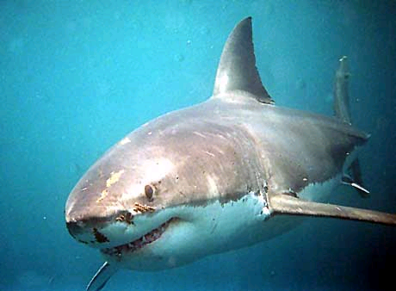
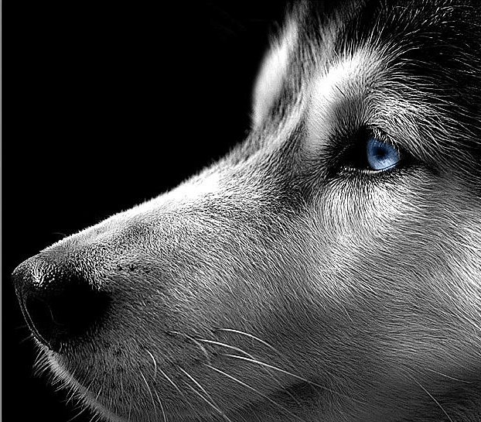
origin - corporate culture & market
How efficient, how flexible should the corporation be?
high
2
4
specialisation
1
3
1
3
low
low
market dynamics
high
specialisation versus flexibility

Slide 18
origin - corporate culture & market
How efficient, how flexible should the corporation be?
1. Quadrant – Generalist in a static environment
  High competition
  Only the strongest survives: competitive through size
  Universal success models: shark, dinosaur
2. Quadrant – Specialist in a static environment
  Conquering ecological Niches
  Highly adapted efficiency specialists
  Niche dwellers: polar bear, camel
3. Quadrant – Generalist in a dynamic environment
  cut-throat competition
  Flexible process innovators: wolf
  survival under changing conditions, social system
4. Quadrant – Specialist in a dynamic environment
  Taking advantage of „windows of opportunity“
  Agile Specialists, Nomads, opportunity picker, migrant birds, swarm
increasing market dynamics require higher flexibility.

Slide 19
origin - from mass market to individualized products the Organisation responds to market needs
autonomous decisions,
multiple, direct
communication flows
strategic
(top management)
5
strategic
(top management)
%
communication-/
decision
bottle necks
5
%
managerial
(middle management)
value creation
(Experts-
Networks)
5
5
3
%
5
%
Increase of
Process autonomy
operational
(clerical work)
4
operational
(simple work)
0
6
%
0
%
= Information flow
Taylor pyramid
traditional functional hierarchy
Experts diamond
autonomous service network

Slide 20
origin – corporate culture & market influence of the Organisation on the culture.
Taylor-pyramid
experts-diamond
Lead by orders and rule
Tightly managed departments
Remuneration on hours works
Penalties on failures
Secret knowledge
Safe jobs through rigid structures
Working for money
Vertical communication only
External control of work
Predefined jobs
Operation & control are split
Distrust
Lead through principles and values
Autonomously acting teams.
Remuneration based on success
Rewarding success
Shared knowledge
Confidence through cultural integration
Self-confidence through visible contribution to success
Direct peer-to-peer communication
Self controlled work
Evolving (self organising) jobs
Self optimizing processes
Trust
Taylor-pyramid vs. experts-diamond

Slide 21
origin – corporate culture & market
Leadership in a dynamic environment
In a dynamic environment multiple complex decisions have to be made.
In the Taylor pyramid this situation leads an information overflow.
In the experts diamond peers communicate directly.
Management functions merge with operational functions to independent self optimising processes.
Experts led by principles follow their own autonomous decisions.
They make autonomous but visible decisions.
The „boss“ becomes a coach rather than the „1st clerk“.
Mutual respect of personality and competency replace daily order and detailed rules.
The culture has to adapt from “feudal” to “team oriented”
The deal is: „autonomy plus transparency“.

Slide 22
origin – corporate culture & market market dynamics and organisation
In a static environment the best adapted specialist wins.
In a dynamic market the adaptable generalist is the winner.
Only a few corporations are equally well positioned in both environment.
But in fact successful corporations need the power of the two distinct cultures.
  Highly efficient processes need an industrial organisation
  Market driven substructures need an experts network organisation
To be robust against dynamics corporations need the „power of two hearts“.

Slide 23
Diagnosis
How to determine corporate culture?
A corporate culture can be grasped already intuitively using a few key parameters.
A systematic determination can be done using different cultural model.
However no commonly accepted universal cultural model has emerged yet.
The competing values framework (CVF) is currently the best supported model around.
Questionnaires and the Organizational Culture Assessment Tool (OACT) can be used.
For the diagnosis of a quality culture a more focused model is still missing.
In order to analyse the quality culture of a corporation an appropriate model, questionnaires and a Tool are still missing.

Slide 24
Diagnosis - policies, procedures & practices
Where does corporate culture becomes obvious?
Success How is success measured
Respect How do you demonstrate respect for colleagues, customers, vendors, the community
Problems How do you solve customer and employee problems
Decisions How are decisions made
Innovation How to do encourage new ideas and innovation
Time How to you weigh the relative importance of short term profitability versus long term goals
Rewards How are achievements rewarded
A few parameters already disclose the cultures nature.

Slide 25
Diagnosis determining culture types by the competing values framework.
organic
Clan
Adhocracy
internal
external
Hierarchy
Market
mechanistic
Der The type of culture are key to an effective organization.

Slide 26
Diagnosis determining culture type using the competing values framework
The traditional family business
The innovative start-up company
organic
Types of culture are key to an effective organization.
Strength and consistency of corporate culture are less important.
There may be a consistent but weak culture.
However, no strong but inconsistent culture.
There are questionnaires and measurement tools available.
clan
Dominant Attributes: Creativity, entrepreneurship, adaptability, dynamism
Leader Style: Entrepreneur, innovator, risk taker,
Bonding: entrepreneurship, Flexibility, risk
Strategic emphasis: Towards innovation, growth, new resources
Dominant Attributes: Cohesiveness, participation, teamwork. sense of family
Leader Style: Mentor, facilitator, parent-figure
Bonding: Loyalty, tradition, interpersonal cohesion
Strategic emphasis: Towards developing human resources, commitment, morale
adhocracy
internal
external
Dominant Attributes: Order, rules and regulations, uniformity, efficiency
Leader Style: coordinator, organizer, administrator
Bonding: Rules, policies and procedures, clear expectation
Strategic emphasis: Towards stability, predictability, smooth operations
Dominant Attributes: competitiveness, goal achievement environment exchange
Leader Style: decisive, production- and achievement oriented
Bonding: Goal orientation, production, competition
Strategic emphasis: Toward competitive, advantage and market superiority
hierarchy
market
Government
conglomerate
dinosaur
The flexible high-performance enterprise
mechanical

Slide 27

Design
How can we create a quality culture?
TQM thinking - quality cannot be achieved in isolation.
Leadership - the top management as a visible example
Consistent action - contradictions quickly spoil all effort.
Orientation - the customer, rather than the product.
Empowerment - Quality is everybody's job.
Personnel - select carefully and train them.
Feedback - immediately and relentlessly authentic.
Transparency - goals, successes, deviations are public.
Rules - and a few clear, but strictly binding rules.
Promotion - rewards for contribution to the corporate success.
Empathy - Anyone who is committed belongs to "us".
Flow - balance of challenge and support
The content is not new – the implementation is the challenge!

Slide 28
examples culture is a corpration‘s strongest power.
It may also be a serious obstacle to success:
  It resists a direct engineering.
  It can be only changed in the medium and long term.
  It affects the company directly and often unconsciously.
  Only a few companies managed to control these instruments.
Success stories…
  In search of excellence –Tom Peters found early hints to this phenomenon.
  Toyota – where Taichi Ohno created the lean production.
  Apple – Apple is Steve Jobs. Company and founder form an organic whole.
  Google – a rule based market, entrepreneur’s spirit, small cells form part-time start-ups – and can move up.
  Hidden champions – less known, small or medium sized companies, world market champions in small segments.

Slide 29
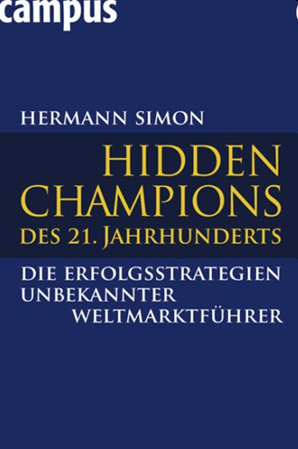
Examples – the hidden champions the success strategies of lesser know world market leaders
The success of German exports does not originate from major German players.
But to a group of companies which are world market leaders in their segments.
Although little known, they are unsurpassed in the world for decades.
The "Hidden Champions" prefer to work in a clandestine way.
In Germany alone there are over 500.
Innovation is their outstanding feature.
Nearly all of them have achieved world market leadership.
Because they all had started as pioneers.
For technological aspects or the way they approached their markets.

Slide 30
Examples – the hidden champions their success factors
Corporate objectives
  active, aggressive, optimistic
  focused on core competencies
  sworn in on common goals and values
The market
  narrowly defined
  approached in a highly specialized way
  Deep assortments - not wide
  high degree of specialization
  unmatched perfection
  their market is the world
The customers
  Direct customer contact
  Long-term business
  Customer loyalty more important than short-term profit
Innovation
  2 Sources: customer and specialization
  Focus on a specialty areas
  Set the pace with new innovations
The competition
  Actively seek the performance enhancing confrontation with the strongest competitors.
  Always at least one point better than the competition.
  Compete on service and quality.
The partners
  core competencies
  Long-term relationships
  mutual trust
  Follow the customers around the world

Slide 31
Examples – the hidden champions their success factors
The Team
  Very strong and unconventional
  corporate cultures.
  Strong identification with the goals and values ​​of the company.
  Permanent staff: low turnover, low absenteeism
  Little friction.
  “During weekends, we beat our competitors."
  Key factor in employee training,
  Massive investments into trainings,
  Learning on the job more important than formal programs.
  Very careful staff selection.
  new employees are tested in the workplace.
  Newbies either stay long time or leave soon again.
The executives
  inexhaustible Power and Energy
  clear priorities
  Fully business focused
Leadership style:
  authoritarian in the values​​, goals, core competencies
  participatory and leaving freedom of choice in the details of implementation.
  Work on the flow principle.
  Appreciation of achievements play a prominent role.
  A “sworn community"
  Enterprise and founder personality always form a whole.

Slide 32
Outlook
What is left to be done?
Use the power of the – right - corporate culture!
A strong Q-culture complements the Q-craft, it is not replace it.
Follow the example of the hidden champions!
Be patient - cultural change takes time!
Start with a diagnosis!
Stay honest - otherwise it goes wrong!
But try to change it only if you have the means to do so!
The corporate culture is the strongest corporate force. To change it, you must start at the top of the company.

Slide 33
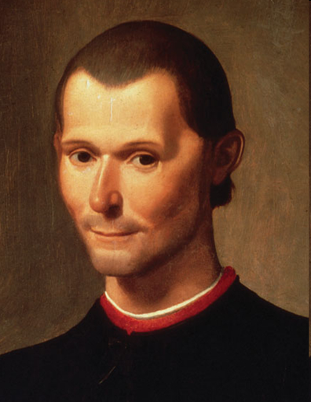
Niccolo Machiavelli
(1469-05-03 – 1527-06-21 in Florence )
„It is impossible to convince a man, whose way to act made him successful, he would be well advised to act differently henceforth.
This is the reason why a mans luck turns; when the time change but he doesn’t change his way to act.“

Slide 34
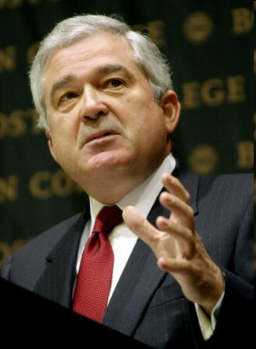
Louis Gerstner
IBM chairman of the board and CEO from April, 1993 until 2002.
From a former CEO of IBM…
“I came to see, in my decade at IBM, that culture isn’t just one aspect of the game - it is the game.”
- Louis Gerstner, “Who Says Elephants Can’t Dance” (2002)

Slide 35
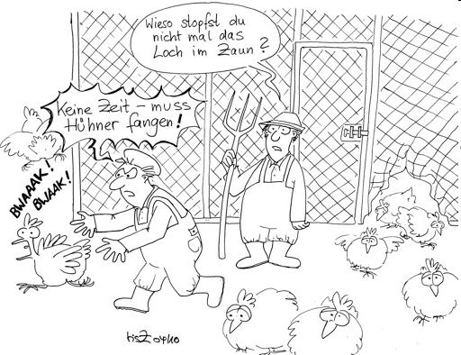
rhetorical question can we afford to deal with corporate culture?
Why don‘ t you mend the fence?
No time – need to catch chicken!

Slide 36

questions - acknowledgements – suggestions?

Slide 37

Attention
Backup slides

