Slide 1
Identity Management for the Cloud
New answers to old questions
10. Anwenderkonferenz Softwarequalität, Test und Innovationen
6. und 7. September 2012 Alpen-Adria-Universität Klagenfurt
Dr. Horst Walther, Business Advisor Operational Risk Management Member of the VCB & Company LLP, London,

Slide 2
agenda
Where is the problem? Why do we need to talk about IdM in the cloud?
The slow move towards the cloud The cloud did not come as a surprise
Finally the fortress security model fails But corporations had a hard time to accept the facts
Models, services & actors become standardised The NIST Conceptual Reference Model
Cloud Computing’s deadly sins by Mike Small
Often IAM is meant when IM is said IAM = Identity Management (IM) + Access Management (AM)
IAM before & in the Cloud What changes for the consumer, when moving into the cloud?
OASIS view relevant standards & identified gaps
SCIM Simple Cloud Identity Management by IETF
IdMaaS - Identity Management as a Service Identity Management Moves into the Cloud
Management vs. governance A clear cut between hand-on management & governance is essential
Conclusion What changes, when moving into the cloud?

Slide 3
summary
Since 10 years+ Identity Management in the cloud is discussed.
However it offer few new challenges only.
Neither did the cloud come as a surprise – nor does the requirement for managing identities.
Rather in the cloud a development culminates that was expected since a long time.
Quantitative shifts like higher complexity, more outsourced services & mobile and independent devices occur.
They may well confront corporations with a new aulity – especially those which did not catch up with the steady development.
There is a backlog of standardisation in various areas – with some gaps currently being filled (e.g. SCIM).
However access management, audit & compliance have barely been touched so far. – The development just has started.

Slide 4
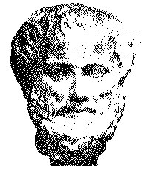
Where is the problem? Why do we need to talk about IdM in the cloud?
Since 10 years+ we are discussing Identity Management in the cloud.
Obviously there seems to be a major issue.
But what makes the difference?
What are old – what are the new challenges?
How do the solutions look like?
What is going on? What comes next?

Slide 5
The slow move towards the cloud The cloud did not come as a surprise
The closed corporate perimeter is blurring
There is a long-term move of sourcing internal services out
Strongly coupled,
static, internal
Weakly coupled,
dynamic, external
Extranets
Internal
Systems
& Data
The cloud
Employee
Partner
Customer
less known
unknown

Slide 6
Finally the fortress security model fails But corporations had a hard time to accept the facts
The company perimeter is no longer the line of defence
A virtual enterprise network requires asset centric security.
Strongly coupled,
static, internal
Weakly coupled,
dynamic, external
The virtual enterprise network goes beyond phsical borders
Internal
Systems
& Data
The cloud
Employee
Partner
Customer
less known
unknown

Slide 7
Challenges – The CIO’s lament Complexity, cloud & mobile drove the change in the last 5 years.
Increased complexity.
There are more things to connect,
More people to connect
With more data than ever before.
It's an end-to-end situation.
The role of IT has changed
From being the custodians of IT to being brokers of IT.
The all-things cloud lures us.
The infrastructure is moving out of the (direct) control.
The devices too are moving out of control the IT.
BYOD & mobile devices are incompatible with the perimeter security model
We go from managing by our hands on to governing via policies & audits.
But generally IT people are not good at governing
And the outlook is: More of the same.

Slide 8
Models, services & actors become standardised The NIST Conceptual Reference Model
NIST: http://www.nist.gov/customcf/get_pdf.cfm?pub_id=909505

Slide 9
The NIST Conceptual Reference Model Cloud Computing obviously raises the overall complexity
5 major participating actors:
Cloud Consumer,
Cloud Provider,
Cloud Broker,
Cloud Auditor,
Cloud Carrier.
3 service:
Cloud software as a service (SaaS),
Cloud platform as a service (PaaS),
Cloud infrastructure as a service (IaaS).
4 deployment models:
private cloud,
community cloud,
public cloud, and hybrid cloud.
5 service characteristics :
on-demand self-service,
broad network access,
resource pooling,
rapid elasticity,
measured service.

Slide 10
Cloud Computing’s deadly sins by Mike Small
Adopting cloud computing can save money.
But many organizations are sleepwalking into the cloud.
Outsourcing the provision of the IT service does not outsource the customer’s responsibilities.
The deadly vice of cloud computing of is sloth by inattention to:
Not knowing you are using the Cloud
Not assuring legal and regulatory compliance
Not knowing what data is in the cloud
Not managing identity and access to the cloud
Not managing business continuity and the cloud
Becoming Locked-in to one provider
Not managing your Cloud provider
Of these deadly sins of cloud computing #4 directly applies
Indirectly affected are #2 & # 5
* In medieval times the Christian church created the concept of the seven deadly sins: 1. wrath, 2. greed, 3. sloth, 4. pride, 5. lust, 6. envy and 7. gluttony

Slide 11
Often IAM is meant when IM is said IAM = Identity Management (IM) + Access Management (AM)
Identity & Access Management
Identity Management
Access Management
Model & manage the identity's access to corporate resources.
Define the digital identity
and its life cycle

Slide 12
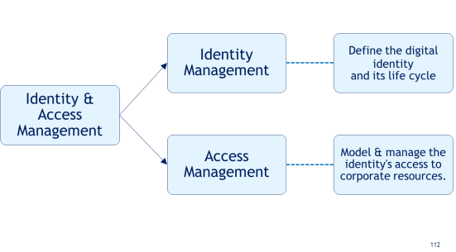
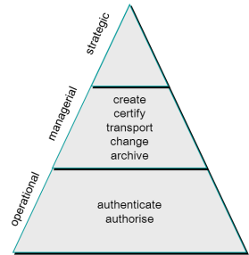
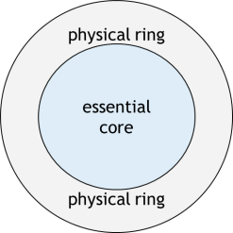
Grouping processes of the Identity- & Access Management The IAM processes may be viewed from different perspectives*
into Identity management & Access Management
Identity management has a justification sui generis.
It is not an appendix of security management
Access management can be built on top of Identity management
into operational and managerial
operational: identify, authenticate and authorise
managerial: administer digital Identities
governance: supervise & direct
into essential and physical
essential: administer and use the essential business functionality
physical: integrate, transport, transform and “provision” to deal with the “cruel dirty world” outside.
* www.GenericIAM.org

Slide 13
IAM before & in the Cloud What changes for the consumer, when moving into the cloud?
Enterprise IAM
Cloud IAM
Mostly partial coverage
Manual & automated processes
Proprietary application interfaces
IAM roles may overlap
Individual, ad-hoc decisions
SSO is a goody
Hands-on management & governance not clearly separated
Low process maturity suffices
Running an IAM is recommended
Total coverage necessary
Full automation required
Standardised interfacing
Clearly defined IAM roles
Policy driven decisions
SSO is essential
Mandatory separation of hands-on management & governance
High process maturity necessary
Running an IAM is mandatory
Well – not much. But it has to be done now.

Slide 14
OASIS view relevant standards & identified gaps
Identified relevant standards
Identified big / obvious gaps
SAML
OpenID
OAuth
SPML
SCIM
WS-Federation
IMI
(XACML) ?
Configuration and association with an IdP is not standardized
No standards or rules for mapping or transforming attributes between different (cloud) domains.
No profiles or standard roles and related attributes
No standards for attributes
No audit standards for IDM systems

Slide 15
Where can the impact of the cloud be felt? The OASIS ‘identity in the cloud’ use cases
OASIS formalized 29 cloud use cases out of (35 received)
Infrastructure Identity Establishment
Identity Management (IM)
General Identity Management
Infrastructure Identity Management (IIM)
Federated Identity Management (FIM)
Authentication
General Authentication
Single Sign-On (SSO)
Multi-factor
Authorization
Account and Attribute Management
Account and Attribute Provisioning
Security Tokens
Governance
Audit and Compliance

Slide 16
Impact on the Identity Management OASIS: More emphasis on provisioning and configuration
Speed - Rapid provisioning:
Automatically deploying cloud systems based on the requested service/resources/capabilities.
Robustness - Resource changing:
Adjusting configuration/resource assignment for repairs, upgrades and joining new nodes into the cloud.
Compliance - Monitoring and Reporting:
Discovering and monitoring virtual resources, monitoring cloud operations and events and generating performance reports.
Transparency - Metering:
Providing a metering capability at some level of abstraction appropriate to the type of service.
e.g., storage, processing, bandwidth, and active user accounts.
SLA management:
Encompassing the SLA contract definition
SLA monitoring and SLA enforcement according to defined policies.

Slide 17
SCIM Simple Cloud Identity Management by IETF
For provisioning user identity to cloud-based service providers.
The SCIM protocol …
exposes a common user schema and extension model
is expressed in JSON (JavaScript Object Notation) or XML over HTTP
uses a RESTful (Representational State Transfer)-API.
maps to SCIM LDAP inetOrgPerson
binds to SAML
Is supported by several security software & cloud vendors
Cisco, Courion, Ping Identity, UnboundID and SailPoint; Salesforce, Google and VMware.
Version 1.0 of the specification was approved in Dec. 2011.
Proposed milestones …
mid. 2012: the SCIM core schema
mid. 2012: RESTful interface definition,
mid. 2012: use cases as a living document by the end of summer
mid. 2013: formalized SAML bindings
mid. 2013: LDAP mappings.

Slide 18
SCIM - Modes & Flows
CSP → CSP
Cloud Service Provider to Cloud Service Provider Flows
ECS → CSP
Enterprise Cloud Subscriber to Cloud Service Provider Flows
Create Identity (Push)
Update Identity (Push)
Delete Identity (Push)
Sync Identity (Push & Pull)
SSO Trigger (Push)
SSO Trigger (Pull)
Password Reset (Push)
Create Identity (Push)
Update Identity (Push)
Delete Identity (Push)
SSO Pull

Slide 19
IdMaaS - Identity Management as a Service Identity Management Moves into the Cloud
IDMaaS = IdM + SaaS
10 key criteria to be considered:
Be sure about the service level agreements (SLAs).
Explore the compliance / liability ramifications
Define how control will be shared?
Plan and define the interface with the service provider.
Consider the applications to integrate into the solution.
Align your security model with the service provider.
Understand the business disruption caused by the move.
Explore the effort of changing back / to another provider
Make sure your provider is the right one for IDMaaS as well.
Consider the whole life cycle costs under different scenarios.
If you confidently cover all 10 points you may move to IdMaaS
Notes:
Always be sure to inquire about the service level agreements (SLAs) that will be put into place. SLAs can make or break a hosted offering, so be aware that the SLAs directly support your institution’s goals and objectives.
Fully explore the liability ramifications of outsourcing your identity management operations. How will this affect your compliance regulations and requirements? Do you or your vendor have any compliance or measuring tools available to mitigate any noncompliance issues? Will the vendor provide periodic compliance reports or scorecards?
Think about how much control you really want regarding how the service should be implemented. Will you define all the requirements, or will your customers be involved as well? How many of these decisions do you wish to be in the hands of the actual service provider?
Carefully plan and define exactly how you will interface with the service provider. Define integration points and standards between you, the service provider, and any third parties, as well as determining how internal administrators will control and monitor those access points. Make sure the vendor has a high privilege account management feature to achieve this type of fine-grained administrative access.
Consider what applications you will wish to integrate into the solution. Will this only involve web-based applications, or will mainframe and web services also be incorporated?
Security is a huge concern for most companies when it comes to any outsourcing endeavor. Make sure your security model is fully defined and that the service provider can abide by all the requirements in that security model. Find out what policies the provider has in place for controlling access to systems containing client data. Also find out what their best practices are for screening and hiring employees. As many service providers run a multi-tenant software infrastructure within their data centers, be sure to find out what safeguards will be put in place to protect you from other tenants.
Be sure to clearly understand how much business disruption might arise from this service. Make sure your provider is using a software solution that can be fully configured and tested outside of a production environment, so applications won’t have to be taken offline, and can be remotely deployed to keep service levels intact. Clearly define who will assume risk if there are availability or performance issues.
Fully explore just how viable it would be to take the solution in-house eventually. Does the technology support an easy transition, should the need arise?
Does the vendor have a solid and qualified history with identity management deployments? This is a question relevant to both your initial deployment and any future shifts to an in-house framework
And don’t forget the age-old question, “How much is this going to cost me?” Hosted identity management is a subscription-based service, but find out if it is going to be user-based, usage-based or a flat rate. Also inquire how often you will be billed and if there are any extra costs for implementation and/or customizations.

Slide 20
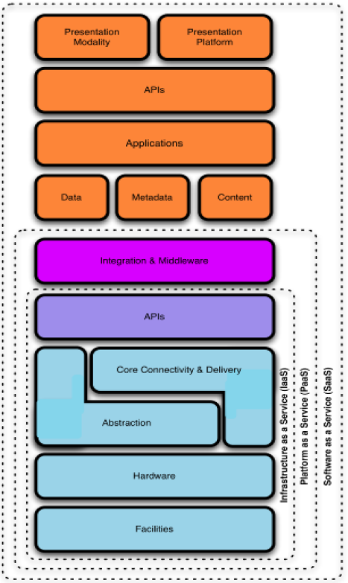
Management vs. governance A clear cut between hand-on management & governance is essential
Saas
governance
management
Paas
governance
management
Iaas
governance
management
Depending on the service model the level from where on governance replaces management is different.

Slide 21
Big Picture: the Context is the Industrialisation of Service
2 global forces change the environment.
Compliance
Compliance enforces the use of infrastructure standards.
ITIL is just the beginning – CoBIT, ValIT and others will follow.
The cloud offers a framework for the implementation.
ITIL, SOA, compliance frameworks are details of a bigger picture.
Globalisation
Market forces enforce the concentration on core competencies.
Non-competitive activities will be standardised.
They will be sourced globally at low prices,
outsourced / cloud-sourced / off-shored
… or performed according to best practice reference models.
enterprises
Standardisation
Automation
Modularisation
continuous improvement
core competences

Slide 22
Conclusion What changes, when moving into the cloud?
Well, not much!
Moving to the cloud doesn‘t offer fundamentally new challenges.
Full coverage, automation, single-sign-on, user-self-service, … should have been IAM feature before as well.
Out-sourced & off-site running applications were in use since years.
Cost pressure & increased complexity are the real differentiators
They enforce one more step towards the industrialisation of services.
It‘s about …
Quantity → Quality

Slide 23
questions - acknowledgements – suggestions?

Slide 24
Attention Backup slides

Slide 25
Standards
SAML
Most mature, detailed, and widely adopted specifications family for browser-based federated sign-on for cloud users
Enables delegation (SSO)
Multifactor authentication
Support strong authentication and web SSO, avoid duplication of identity, and share only selected attributes to protect user privacy
Platform neutrality. SAML abstracts the security framework away from platform architectures and particular vendor implementations.
Business-to-business and employee-facing use cases
Shibboleth
Led by Internet2 to provide peer-to-peer collaboration using a federated identity infrastructure based on SAML.
Huge adoption rate in university and research communities
Liberty Alliance
An organization of vendors and enterprises that is largely perceived as having formed in response to Microsoft’s Passport efforts.
Identity federation framework (ID-FF) and identity Web services framework (ID-WSF). Their ID-FF work, which has now been incorporated into SAML 2.0.
Provides testing services for SAML 2.0 as well as their own protocols.
SPML
Emerging
Xml-based framework being developed by oasis for exchanging user, resource, and service provisioning information among cooperating organizations.
XACML
XACML is an oasis-ratified, general-purpose, xml-based access control language for policy management and access decisions.
Xml schema for a general policy language, processing environment model to manage the policies and to conclude the access decisions.
A standard way to express authorization policies across a diverse set of cloud services and externalize authorization and enforcement from the application
OAUTH
OAUTH is an emerging authentication standard that allows consumers to share their private resources (e.g., photos, videos, contact lists, bank accounts) stored on one csp with another csp without having to disclose the authentication information
Supported via an API by service providers including GOOGLE, TWITTER, FACEBOOK, and PLAXO
OPENID
OPENID an open, decentralized standard for user authentication and access control, users can log on to many services with the same digital.
However trust issues remain
WS-*
Driven by a collaborative effort between Microsoft, IBM, VeriSign, RSA Security, Ping Identity and others.
Composable suite of specifications for enabling secure Web services.
WS-Trust, WS-Federation, and WS-Policy are evolving mechanisms for layering authentication, authorization & policy across multiple security domains.

Slide 26
Dr. Horst Walther is a business advisor
Horst Walther is member of the VCB & Company, LLP. in London.
+44 208 1237381
horst.walther@vcbcompany.com
He focuses on…
due diligence, audits and potential analysis of the corporate IT,
The development and verification of IT-Strategies and
Change Management in the area of information technology.
He studied chemistry, computer science, oriental studies and economics.
He worked in various companies in the software development and IT management & advisory.

