Slide 1
Workshop: Governance, Risk, Compliance (GRC) & Identity Management
2008-04-25, 09:00-12:30, Track: Workshop I
  Dr. Horst Walther, Kuppinger Cole + Partner
Forum am Deutschen Museum
Museumsinsel 1 • 80538 München
Phone: +49 89211 25170 • Fax: +49 89211 25165
Web: http://www.forumamdeutschenmuseum.de
Dr. Horst Walther, Version 2008-04-21

Slide 2
What is GRC?
Governance, Risk, and Compliance
Governance.
The culture, policies, processes, laws, and institutions that define the structure by which companies are directed and managed. Corporate governance includes the relationships among stakeholders and the goals for which the corporation is governed.
Risk.
The effect of uncertainty on business objectives; risk management is the coordinated activities to direct and control an organization to realize opportunities while managing adverse events.
Compliance.
The act of adhering to, and demonstrating adherence to, external laws and regulations as well as corporate policies and procedures; compliance management is the coordinated activities to stay within internally and externally mandated boundaries.

Slide 3
Definitions governance – risk - compliance
Governance management:
  Organized oversight, requiring comprehensive understanding of mandates, clarity regarding associated roles & responsibilities and meaningful/timely performance information - all necessary to hold the organization accountable
Risk management:
  Identification, assessment and ongoing monitoring of risks (real or hypothesized) and controls – not just to limit downside, but also to maximize opportunity
Compliance management:
  Execution of business processes designed to control/manage risks or deal with issues that arise – continually benchmarked against expected parameters/tolerances

Slide 4
Definitions
IT governance – IT risk – IT compliance
IT Governance:
  IT governance is the responsibility of the board of directors and executive management.
  It is an integral part of enterprise governance and consists of the leadership, organizational structures and processes that ensure that the organization’s IT sustains and extends the organization’s strategy and objectives. [ITGI 2004]
IT Risk Management:
  IT Risk management is the process of planning, organizing, leading, and controlling the activities of an IT organization in order to minimize the effects of risk on an organization's capital and earnings.
IT Compliance Management:
  The state of being in accordance with the relevant legal and regulatory requirements and the IT rules, principles and guidelines derived from those.

Slide 5
CGR would be the better term although governance is the obligation – compliance often is the driver.
compliance
Compliance is the driver to action in most corporations
Most regulations don‘t give clear hints, what actions to take.
Additional assumptions have to be made to interpret the regulations.
Good governance is assumed to result in compliance.
Governance models can be taken as a guidance for implementation.
Most of models deal with the detection, evaluation and mitigation of risks.
Some of the risks are related to identity management.
governance
Risk management

Slide 6
Identity Management is just a part
Only a small fraction of the risks is related to Identity Management.
Corporate governance
The compliance requirements are mostly stated open and vague.
They leave room for interpretation.
In most cases your external auditor will interpret them.
He will check your governance and give advice how to improve.
Following governance models is a good preparation though.
IT-Governance is just a part of the overall corporate governance.
Identity Management in turn covers only a fraction of the it governance.
It governance
Identity management

Slide 7

To meet mandatory requirements the implementation of “voluntary” governance is necessary

Slide 8

Compliance Defined
Compliance:
“In management, the act
of adhering to, and demonstrating adherence to laws, regulations or policies”
source: www.wikipedia.org
Notes:
Betonen: nicht nur „adherence to“, sondern auch „demonstrating adherence to“
Compliance-Anforderungen stark überlappend, deshalb: keine Insellösungen zur Erfüllung jeweils eines einzelnen Standards, sondern Aufbau und Betrieb eines übergreifenden ISMS (Informations-Sicherheits-Management-Systems)
Allgemein akzeptierte Best Practice für ein ISMS: ISO 27001

Slide 9
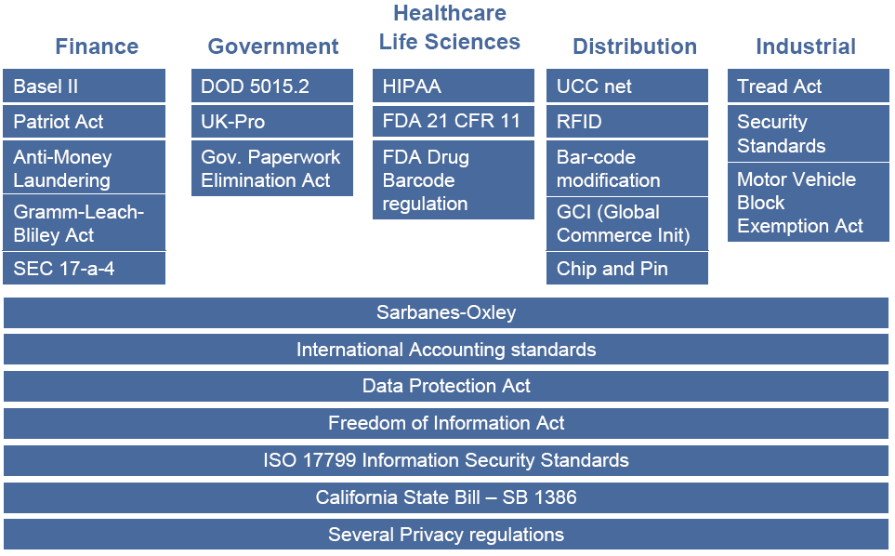
Regulations to be compliant with

Slide 10
What to be compliance with
Regulations with focus on Germany
BDSG Bundesdatenschutz-Gesetz
EnWG Energiewirtschaftsgesetz
SOX Sarbanes-Oxley Act
HIPAA Health Insurance Portability and Accountalability Act of 1996
FDA 21 CFR Part 11 Pharmazeutische Industrie
Basel II Eigenkapitalregeln
8. EU-Richtlinie Prüfung des Jahresabschlusses und des konsolidierten Abschlusses
HGB Handelsgesetzbuch
KonTraG Kontroll- und Transparenz-Gesetz
EU-Richtlinie 95/46/EG European Privacy Directive
EU-Richtlinie 2002/58/EC Directive on privacy and electronic communications
§25 Kreditwesengesetz
FFIEC US Banken, 2-Faktor Authentisierung für hochvolumige Transaktionen

Slide 11
What to be compliance with
Regulations with focus on Germany
SigG Signaturgesetz
KgVO Krankengeschichtenverordnung
RöVO Röntgenverordnung
GDPdU Digitale Betriebsprüfung
DOMEA Dokumenten-Mgmt. und el. Archivierung
SEC (Rule 17a-3 & 17a-4) Elektronische Archivierung
US Electric Reliability Council US Energiewirtschaft
BSI Grundschutz Security
FIPS Federal Information Processing Standard
ISO 17799 Security
COBIT Control Objectives for Information and related Technology
ITIL IT Infrastructure Library

Slide 12
Corporate Governance is embedded
OECD Principles of Corporate Governance
Corporate governance is only part of the larger economic context in which firms operate that includes, for example, macroeconomic policies and the degree of competition in product and factor markets.
The corporate governance framework also depends on the legal, regulatory, and institutional environment.
In addition, factors such as business ethics and corporate awareness of the environmental and societal interests of the communities in which a company operates can also have an impact on its reputation and its long-term success.

Slide 13
Sarbanes-Oxley Act – Software-Relevant Sections
Section | Requirement
301 | The audit committee shall establish procedures for the confidential, anonymous submission by employees of the issuer of concerns regarding questionable accounting or auditing matters
302 | Management responsibility for effective disclosure controls and procedures over financial reporting, operations and compliance Disclosure of significant deficiencies in internal control to audit committee and external auditors Certification of contents of SEC reports by CEO and CFO
401 | Include in financial reports all material correcting adjustments that have been identified by the external auditors Provide investors with a clear understanding of the company’s off-balance sheet arrangements and their material effects
404 | Annual report should include a report by management on the effectiveness of internal control over financial reporting Documentation of control design and effectiveness testing Disclosure of any material weaknesses Attestation by external auditors Note: Further periodic disclosure requirements are covered under Section 302
409 | Rapid and current information on material changes in the financial condition or operations, including trend and qualitative information for protection of investors and in the public interest

Slide 14
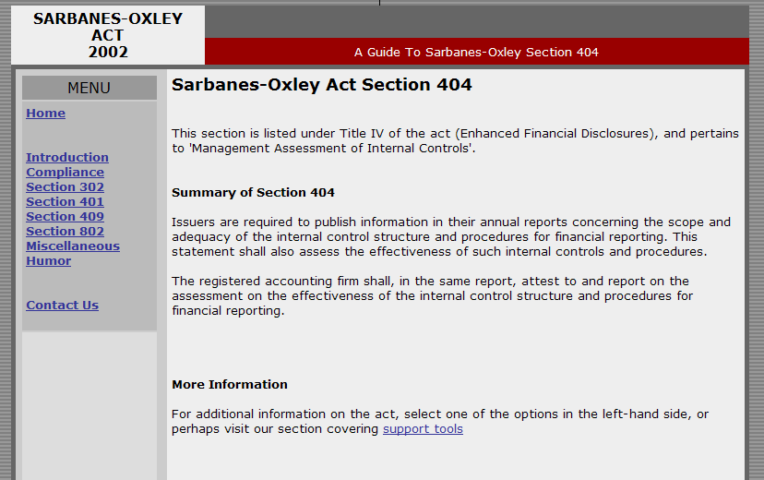
Sarbanes-Oxley Act Section 404 a few tiny sentences stir up the business world

Slide 15
Recommendation: Don't go overboard on 404
Forrester analyst Michael Rasmussen offers these SOX 404 compliance tips.
Relevance:
Focus on financial systems and processes. For example, processes that generate revenues are relevant - but archiving emails less so.
Risk:
Materiality is meaningful because it guides judgments related to financial reporting. First-year SOX compliance focused too much on risks that were insignificant.
Reasonable:
Absolute assurance is impossible to achieve and too expensive to attempt.

Slide 16
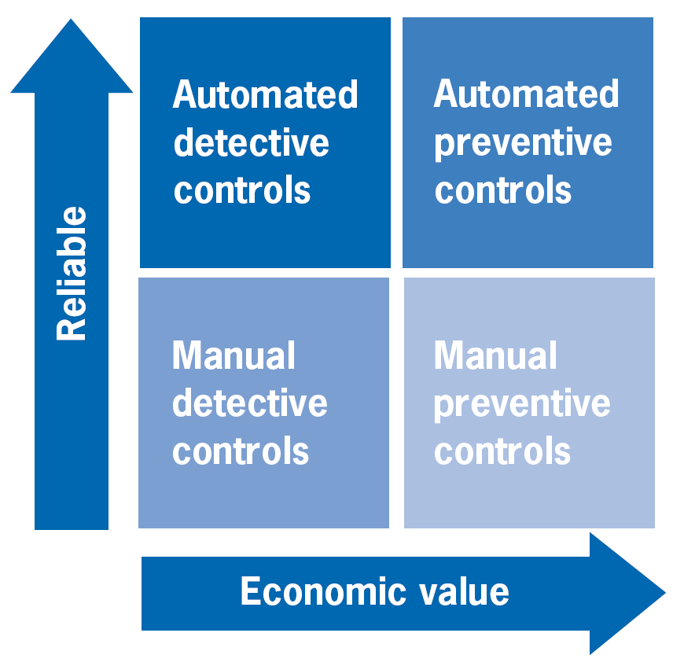
GRC controls detective vs. preventive – manual vs. automated
controls can be classified as preventive or detective.
  They either prevent errors before they occur or
  They detect errors after they have occurred but in time to correct them before they do real damage.
Both types of controls are important.
preventive controls are preferred to detective ones.
  detective controls act after an error has occurred, this means that the undetected errors go on to have a negative impact on the business.
  preventing errors is cheaper than to detecting and fixing them.
Preventive controls generally have a higher “economic value” to an organization.
detective controls may enable an acceptable control environment to meet minimal requirements.
To improve the bottom line a proper balance of detective and preventive controls is necessary.

Slide 17
GRC controls examples in 4 categories
Examples of detective and preventive controls
Detective Controls are designed to identify an error or exception after it has occurred. Examples include:
  Exception reports
  Reconciliations
  Reviews of operating performance
  Periodic inventories
Preventive Controls focus on preventing errors or exceptions. Examples include:
  Use of checklists
  Training
  Proper segregation of duties
  Authorization levels/approvals
Examples of manual and automated controls
Manual Controls operate through human intervention. They are the most flexible but are also subject to human error. Examples include:
  Comparison of amounts entered to source documents
  Signatures/initials noted on completed documents
  Budget-to-actual reviews
  Re-performance of computations
Automated Controls operate through and within information technology systems. Examples include:
  System access controls
  Data entry requirements prior to transaction processing
  Automated balancing and reconciliations
  Automated flags that identify possible invalid or duplicate entries/data

Slide 18
ISACA GRC–Advice
Think Big, Implement Small

Slide 19
governance
By governance we mean ‘the systems and processes concerned with ensuring the overall direction, effectiveness, supervision and accountability of an organisation’.

Slide 20

What is Corporate Governance
“Grandfather” of Corporate Governance Definitions
Corporate governance is the system by which business corporations are directed and controlled.
The corporate governance structure specifies the distribution of rights and responsibilities among different participants in the corporation, such as, the board, managers, shareholders and other stakeholders, and spells out the rules and procedures for making decisions on corporate affairs.
By doing this, it also provides the structure through which the company objectives are set, and the means of attaining those objectives and monitoring performance.
Attributed to:
OECD Principles of Corporate Governance, 1999 (revised 2004)

Slide 21
History of COBIT
1996 - COBIT was developed by ISACF (Information Systems Audit and Control Foundation)
1998 – Founding of the ITGI (IT Governance Institute)
1998 – ITGI begins an initiative for better IT Governance, focused around COBIT
http://www.isaca.org
http://www.itgi.org

Slide 22
CObIT

Slide 23
IAM-Governance & IT-Governance
IT-Governance-Reference models cover IAM too – in principle
Business
view
Maturity level
Business architecture
Technical
view
Security- and service management
Enterprise specific processes and procedures
processes

Slide 24
You can’t take a model of the shelf there is no “one fits all” – need to compose from several sources.
Corporate
strategy
IT-strategy
Compliance
IT-alignment /
IT-Value contribution
Security
Service Management
ValIT
COSO
CoBIT
ISO
17799
ITIL
Mapping to the business architecture
Corporate governance →
← IT governance
business-
architecture
IT-infra-
structure

Slide 25
So where to start?
Taking the helicopter view IT-governance starts with COBIT.
In a top-down integration of reference models corporate governance meets IT-governance in the COSO / COBIT model.
It is followed by a maturity model level
By a business architecture level
a security and service management level
and finally the process level.
The business side (IT demand) is best expressed in terms of CSO / COBIT.
The Quality- and IT-security Standards are positioned more at the operational level.
CMMi is located somewhere in-between
Business
view
Maturity level
Business architecture
Technical
view
Security- and service management
Enterprise specific processes and procedures
processes

Slide 26
COSO…The Internal Control Framework
COSO = Committee of Sponsoring Organizations of the Treadway Commission
Internal Control is defined as a process, effected by an entity’s board of directors, management and other personnel, designed to provide reasonable assurance regarding the achievement of objectives in the following categories:
  Effectiveness and efficiency of operations
  Reliability of financial reporting
  Compliance with applicable laws and regulations
COBIT = Control Objectives for Information and related Technology, a robust framework approach for managing risk and control of information technology.

Slide 27
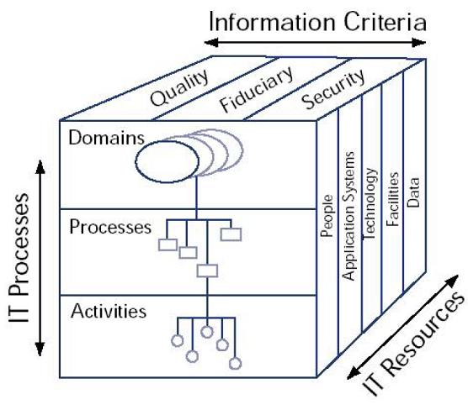
CObIT Components
Designed for three distinct audiences
Management
  To help them balance risk and control investment in an often unpredictable IT environment
Users
To obtain assurance on the security and controls of IT services
Information Systems Auditors
  To substantiate their opinions and/or provide advice to management on internal controls

Slide 28
The Five Components of COSO
Monitoring:
Assessment of control system over time
Information & Communication:
Access and flow of information
Control Activities:
Policies/procedures that ensure directives are carried out
Risk Assessment:
Identification and analysis of risks to achieving objectives
Control Environment:
Sets the tone, influencing control consciousness

Slide 29
Risk management
What is all about

Slide 30
What is Risk Management? and what does it mean to the Identity Management?
Risk = amount of damage * probability of occurance
The goal of Risk Management is to minimise the risks and keep the chances.
The major processes of risk management are …
  Identity risks:
    Determine which risks will probably influence the business.
  Quantify risks:
    Evaluate the risks in order to estimate its possible impact.
  Develop a risk response:
    Develop mitigating actions.
  Risk Response Control:
    Determine impact of actions and run all processes in a cycle.
Risk based Identity Management is more effective, less expensive and of lower complexity than an overall high level of security.

Slide 31
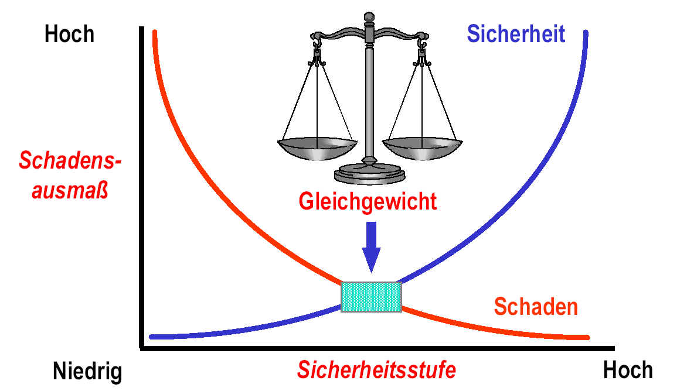
Balancing risks vs. costs
IT-Security = Risk Management
High
degree of
damage
security
equilibrium
damage
Low security level high

Slide 32
the risk Matrix determining areas for immediate action
low
medium
high
Very high
company endangered
Severity of impact
actions necessary
act on own discretion
  low medium high very high
Probability of impact
caption:
= company endangered, act on issues immediately
= urgent action necessary, plan and realise appropriate measures.
= action on the discretion of the Information security officer

Slide 33
Risk Mgmt Processes
Risk Identification
Risk Quantification
Risk Response Development
Risk Response Control

Slide 34
Risk Identification
The process of determining which risks are likely to affect the project and documenting the characteristics of each.
Inputs include:
  product description
  other process outputs such as WBS, cost estimates, staffing plan, procurement management plan, etc. (whatever should be used to identify risks)
  Historical information such as project files, commercial databases, and project team knowledge (lessons learned, etc.)
Methods used during risk identification: checklists, flowcharting, and interviewing (risk oriented interviews with various stakeholders)
Outputs include:
  Sources of risk (categories of possible risk events such as changes in requirements, design errors, poor estimates, etc.)
  Potential risk events including probability of occurrence, alternative possible outcomes, expected timing of the events, and anticipated frequency.
  Risk symptoms (indirect manifestations of actual risk events)
  Inputs to other processes: The risk identification process may identify a need for work in other areas. For example, the WBS may be insufficient.

Slide 35
Risk Quantification
The process of evaluating risks and risk interactions to assess the range of possible project outcomes.
Inputs include: stakeholder risk tolerances, sources of risk, potential risk events, cost estimates, and activity duration estimates.
Methods used during risk quantification: include:
  Expected monetary value: risk event probability * risk event value
  Statistical sums: used to calculate a range of total project costs from the cost estimates for individual work items.
  Simulation: Uses a representation or model of a system to analyze the behavior or performance of the system.
  Decision trees: a diagram that depicts key interactions amoung decisions and associated chance events as they are understood by the decison maker.
  Expert judgment: can be applied in lieu of or in addition to the mathematical techniques. (For example, risk events could be described as having a high, medium, or low probability of occurrence and a severe, moderate, or limited impact.
Outputs include:
  Opportunities to pursue, threats that require attention
  Opportunities to ignore, threats to accept

Slide 36
Risk Response Development
The process of defining enhancement steps for opportunities and responses to threats.
Inputs include:
  Opportunities to pursue, threats that require attention
  Opportunities to ignore, threats to accept
The methods used in risk response development include: procurement, contingency planning, alternative strategies, and insurance.
Outputs from risk response development:
  Risk Management Plan: documents the procedures that will be used to manage risk throughout the project. Also documents who is responsible for managing various areas of risk; how contingency plans will be implemented, and how reserves will be allocated.
  Inputs to other project management processes such as contingency plans, alternative strategies, anticipated procurements, etc.
  Contingency plans: pre-defined action steps to be taken if an identified risk event should occur.
  Reserves: provisions in the project plan to mitigate cost and/or schedule risk. The term is often used with a modifier such as management reserve, contingency reserve, or schedule reserve to provide further detail on what types of risk are meant to be mitigated. (the specific meaning of the modifier and the word reserve varies with the application area)
  Contractual agreements (to avoid or mitigate threats)

Slide 37
Risk Response Control:
The process of responding to changes in risk over the course of the project.
Inputs to risk response control include:
  Risk Management Plan
  Actual risk events: identified risk events that have occurred
  Additional risk identification
Methods used during risk response control: workarounds and additional risk response development.
Outputs include: corrective action (implementing contingency plans and/or workarounds) and updates to risk managment plan

Slide 38
GRC & Identity Management
What is all about

Slide 39
10 top compliance issues the auditors findings hitlist
Unidentified or unresolved SOD -segregation of duties issues
Operating System access controls supporting financial applications or Portal not secure leaving backdoors
Database (e.g. Oracle) access controls supporting financial applications (e.g. SAP, Oracle, Peoplesoft, JDE) not secure –leaving backdoors
Development staff can run business transactions in production
Large number of users with access to all kinds of “super user" transactions in production
Terminated employees or departed consultants still have access
Posting periods not restricted within GL application
Custom programs, tables & interfaces are not secured
Procedures for manual processes do not exist or are not followed
System documentation does not match actual process.

Slide 40

The GRC Challenge
IT privileges are in a mess
  30% of privileges are incorrect
  People retain rights long after they change jobs or even leave
  No control over who has what, and why
  Many instances of toxic combinations of access rights
This poses significant risk
  Security and operational risk
  Fraud and financial risk
  Reputation and other risks
Auditors and regulators are not happy
  Need to control (reduce and mitigate) risk
  Must report on remaining risk
Related issues
  IT privileges are difficult to manage (direct & indirect costs)
  Difficult to deploy business-oriented Identity Management

Slide 41
Role Management & compliance two arbitrary examples
Segregation of Duties
  ISO17799 10.1.3
  COBIT 4.0 PO4.11
Access control
  ISO17799 11.5
  COBIT 4.0 AI2.3

Slide 42
Segregation of Duties
Compliance requirements to role management
ISO17799 10.1.3
  Segregation of duties is a method for reducing the risk of accidental or deliberate system misuse.
  Care should be taken that no single person can access, modify or use assets without authorization or detection.
  The initiation of an event should be separated from its authorization.
  The possibility of collision should be considered in designing the controls.
COBIT 4.0 PO4.11
  Implement a division of roles and responsibilities that reduces the possibility for a single individual to subvert a critical process.
  Management also makes sure that personnel are performing only authorised duties relevant to their respective jobs and positions.

Slide 43
Access control
Compliance requirements to role management
ISO17799 11.5
  Access to information, information processing facilities, and business processes should be controlled on the basis of business and security requirements […]
  The use of utility programs that might be capable of overriding system and application controls should be restricted and tightly controlled.
COBIT 4.0 AI2.3
  Ensure that business controls are properly translated into application controls such that processing is accurate, complete, timely, authorised and auditable.
  Issues to consider especially are authorisation mechanisms, information integrity, access control, backup and design of audit trails.

Slide 44
Compliance for IAM-Processes adding audit controls
Preventive controls
  Prevent undesired situations.
  policies and procedures
    example.: Change Management: “all changes have to be signed off by a formal Change Management Process.“
  80% of all IT-error are caused by human failures.
  Formally review, test and dev develop a rollback Plan for the case of failure.
  Monitoring can be used preventively.
  Preventive controls alone are not sufficient.
Detective controls
  Notify on occurrence of undesired events.
  As fast as possible – but in any case after the fact.
Corrective actions
  Rollback the system into a valid condition again.
  E.g. restoring backup configuration files or disk-Images.
  An effective Change Control and Configuration Management is a necessary prerequisite.

Slide 45
Typical GRC-controls
Evidence on users and privileges
Current User accounts and privileges
  Accounts and privileges applied for.
  Report per user or per requester
  Reports for business superiors
  User accounts und privileges of users per organisational unit
Target system specific Reports
  Available base roles per target system
  User accounts und privileges per target system.
Access Reports
  Who has accessed a system within a period?
  Which systems has a user accessed within a period?
Reconciliation with target systems
Privileges via roles versus direct assignment.
Workflow Reports
  Weekly report on tasks that were not completed the previous week
  Weekly report on provisioning activities by department, location, resource type, etc.
  Were all of the accounts created on time? - How many times did we act late this month?
Licence tracking
  By user – which systems were not accessed by a particular user within a given period?
  By system – which users didn’t access a particular system within a given period?

Slide 46
Privilege, Role, and Policy Management good common practice means doing your homework
Policies
  Model: IT controls, SoD, and risks
  Manage: certify, verify, enforce, and report
Roles
  Model: define and assign
  Manage: review and adapt
Privileges
  Cleanup
  Control quality and risk
Policies
Roles
Privileges

Slide 47
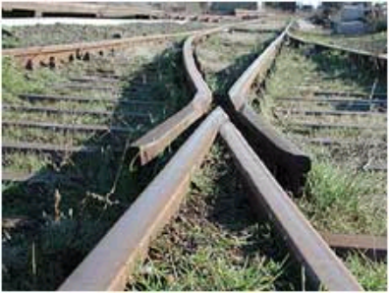
Separation of Duties
Separation of duties (SoD) is an organizational policy.
In a particular sets of transactions, no single role be allowed to execute all transactions within the set.
Used to avoid fraud.
For example:
  separate transactions are needed to initiate a payment and to authorize a payment.
  No single role should be capable of executing both transactions.
  A branch manager’s permission is qualified by an affiliation to a particular branch. Thereby conferring branch manager permission within that branch.
Two forms of SoD exist:
  static (SSD) and dynamic (DSD).
Static separation of duty enforces the mutual exclusion rule at the time of role definition.
Dynamic separation of duty enforces the rule at the time roles are selected for execution by a user.
Notes:
Separation of duties (SoD) is determined from organizational policy. RBAC facilitates splitting administration of the role-user relationship from that of the role-permission relationship.
Since many users in an organization typically perform similar functions and have similar access rights, user functions are separated by role.
Separation of duties requires that for particular sets of transactions, no single role be allowed to execute all transactions within the set.
As an example, there are separate transactions needed to initiate a payment and to authorize a payment.
No single role should be capable of executing both transactions. Separation of duties by role is valuable in deterring fraud since fraud can occur if an opportunity exists for collaboration between various job-related capabilities.
A role can be further qualified with affiliation.
A person’s access could be limited to a geographic or departmental boundary.
For example, a role of branch manager could be qualified by an affiliation to a particular branch thereby conferring branch manager permission only within that branch.
Both static and dynamic forms of separation exist.
Static separation (SSD) means that roles which have been specified as mutually exclusive cannot be included together in a user's set of authorized roles.
Dynamic separation (DSD) means that while users may be authorized for roles that are mutually exclusive, those exclusive roles cannot be active at the same time.
In other words, static separation of duty enforces the mutual exclusion rule at the time of role definition while dynamic separation of duty enforces the rule at the time roles are selected for execution by a user.

Slide 48


Barings Bank – an Example
1995 the Barings-Bank was acquired by the Dutch ING-Group for one pound.
The Bank of the British kings has been one of the noblest in London since 1762 .
Until 1992 Nick Leeson in Singapore started exploiting price differences between Japanese Derivates.
The resulting loss mounted up to 1,4 Billion Dollar.
Leeson was convicted of fraud and sentenced to 6 ½ years in Singapore's Changi prison.
Leeson was responsible for trading derivates in Singapore and for the Back-Office where the Trades were settled.
- A catastrophic mix!
A role based separation of duties would have cost less.

Slide 49
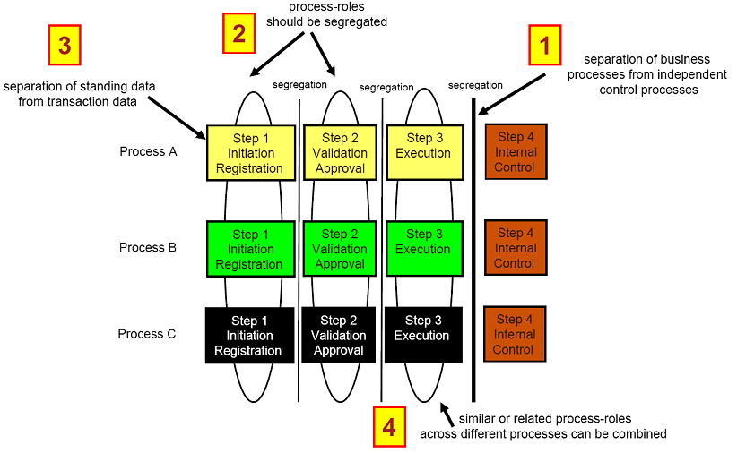
Principles of segregation of duties

Slide 50
Principle of least Privilege (PoLP) risk based decisions are necessary
“a user must not be granted access to more Resources than he / she need to fulfil his / her task..”
The guideline for the creation of access rights
In practice but difficult to implement.
  Requires the assignment of very fine grained access rights.
  access rights are volatile – they change when time goes by.
  This causes major maintenance efforts.
  The basic business logic often is not sufficiently defined.
The „principle of least privilege“ is necessary for high risk access only
For lower risk levels a transparent accountability is sufficient.
  Publish access policy,
  Log all resource access.
  Check all log-files for issues regularly.
  In case of issues act immediately.
principle: PoLP for high – accountability for medium and low Risks.
POLP
high risk
accountability
medium risk
low risk

Slide 51
Reconciliation to provide evidence on the existing deviation from the target situation.
When automated provisioning processes are used the target systems should contain the same information like the source.
For systems with their own administration interface this assumption is not valid.
Therefore the two information stores must be reconciled regularly.
The resulting anomalies have to be dealt with.
should data
(identity management system)
provisioning
reconciliation
actual data
(target systems)

Slide 52
Attestation on a regular basis
Although not necessary in well controlled environments, attestation often required by the auditors.
Attestations means to lookup user role assignments or user privileges on a regular basis.
  Either at a fixed appointed date (when the auditor arrives)
  Or after a defined period of time has passed
If not automated the checks have to be “reasonable” samples.
In some environments the attestation attempt is the only way to detect outdated users.
  E.g. employees of a customer

Slide 53
Required reporting capabilities compliance requirements are major drivers for an evidence solution
Current User
  accounts and privileges
  Accounts and privileges applied for.
  Report per user or per requester
  Reports for business superiors
  User accounts und privileges of users per organisational unit
Target system specific Reports
  Available base roles per target system
  User accounts und privileges per target system.
Access Reports
  Who has accessed a system within a period?
  Which systems has a user accessed within a period?
Reconciliation with target systems
Privileges via roles versus direct assignment.
Workflow Reports
  Weekly report on tasks that were not completed the previous week
  Weekly report on provisioning activities by department, location, resource type, etc.
  Were all of the accounts created on time? - How many times did we act late this month?

Slide 54
GRC
Market Report 2008
23. April 2008
Martin Kuppinger, KCP
mk@kuppingercole.de

Slide 55
GRC: Governance, Risk Management, Compliance
Risk Management
Compliance
Governance
Seite 55
© Kuppinger Cole + Partner 2008

Slide 56
GRC Market:
Level 1
Methodologies
Regulation-specific solutions
Generic GRC tools
OS and application core functions
Seite 56
© Kuppinger Cole + Partner 2008

Slide 57
GRC Market:
Level 2
Application-specific tools
General-purpose tools
Seite 57
© Kuppinger Cole + Partner 2008

Slide 58
Generic GRC tools:
General purpose
All aspects of GRC
All types of applications
Best practices from vendors or consultants
Seite 58
© Kuppinger Cole + Partner 2008

Slide 59
GRC:
Business Control for IAM
The new, evolving GRC market segment
That‘s were many of today‘s tools fit in
GRC – the layer above today‘s IAM
But: No successful GRC without strong IAM foundation
Role Management
Analysis
Attestation
Authorization Management
Risk Management
Seite 59
© Kuppinger Cole + Partner 2008

Slide 60
Layered approach
GRC applications
Business perspective
IAM level
Controlling systems
System level
Implementing controls
Seite 60
© Kuppinger Cole + Partner 2008

Slide 61
Tactical and strategical:
The right tool
No clear leader today
No tool which is best-of-breed in every area
Tactical: What solves current problems best
Strategical: Market will become more mature within 12-18 months
Seite 61
© Kuppinger Cole + Partner 2008

Slide 62

Questions - comments – suggestions?

Slide 63
Questions to the audience please answer the following questions
Does your company have compliance work to do?
  Which regulations do you have to be compliant with?
  Which of them are liked to role management
Has your company implemented a role management?
  Full coverage or restricted to some business areas?
  Do you feel that role management helps getting compliant?
Do you feel, that we have the right methods & tools at hand?
  For doing an effective role management
  For becoming compliant – but efficiently?

Slide 64

Attention
Appendix
From here the notorious back-up slides follow ...

Slide 65
Market segmentation – Level 1 (Overall GRC market)
A layered approach for segmenting the overall GRC market. At the first level there are four categories of general approaches:
Methodologies: Methodologies are consulting-level approaches to deal with GRC requirements in corporations. They usually aren’t directly supported by tools or, if any, on a very abstract level like with some Excel spreadsheets. These methodologies can be applied to the usage of tools though, thus they are often used together with GRC tools. The providers of these methodologies are usually consulting companies with specific domain knowledge.
Regulation-specific solutions: This group consists of IT solutions which are specific to a regulation, like SOX enhancements for ERP tools or specific HIPAA solutions. It is common to these solutions that they can’t be applied to other regulations and GRC threats. They consist of specific checklists and rules for one regulation, for example.
Generic Tools: GRC tools that support the fulfillment of GRC requirements beyond specific regulations. These support a consistent, enterprise-wide approach for managing risks and supporting the fulfillment of Compliance regulations. We currently observe the emergence of a GRC tool market mainly derived from
OS and application core functions: On the operating and application level, logging and reporting features are pretty common. They might support GRC tools but aren’t sufficient for real GRC solutions because the integration and correlation of information derived from heterogeneous systems seems yet far too complex. different constricted tools which have been partially available for some years.

Slide 66
The tools market
There will be no separate role management tools anymore from 2010 on.
There might be some elements which are still offered separately as part of larger solutions.
We expect that most of the vendors will provide, over the next 12 to 24 months, a more complete GRC tool offering.
Role Management and Compliance solutions are even today a part of the broader GRC market.
We strongly recommend the combination of strong GRC methodologies with specific GRC tools for a successful solution to GRC requirements.
The market segment for regulation-specific solutions will diminish over time because these solutions usually don’t provide support for strategic GRC approaches.
We expect a strong growth, far beyond the average of the IT market, for GRC tools.
The GRC tool market will converge over the next two years to provide a common set of features.
Tools which are today focused on specific applications will become more open to support any type of application and system.
We expect a significant number of acquisitions in this market, given the fact that there are many small innovative vendors today and that most of the key players in the Software market have a pretty incomplete GRC portfolio today.
Besides GRC tools, there will be a market segment for real-time event analysis especially on the network and system level, such as evolutions of the Security Information & Event Management (SIEM) tools available today.
We strongly believe in an Enterprise Authorization Management driven by business roles.
Role Management is at the centre of every GRC tool.
Beyond the tool-based offerings we expect vendors as well as integrators and consultants to offer best practice solutions for specific industries and regulations.

Slide 67
GRC tools five core functionalities are promised by the vendors
Analysis
Attestation
Authorization Management
Risk Management
Role Management

