Slide 1

A Practitioner´s Recommendations for a Successful IAM Program
Thursday, May 15th, 17:30 – 18:00
Dr. Horst Walther
  Senior Analyst
  KuppingerCole
  hw@kuppingercole.com

Slide 2
Session: IAM/IAG Maturity Best Practice
Do´s and Don´ts for a Successful Identity Management Project (Manpower)
Part 1
  Rainer Knorpp
  Devoteam
A Practitioner´s Recommendations for a Successful IAM Program
Part 2
  Dr. Horst Walther
  KuppingerCole

Slide 3
agenda
12 recommendations and more to expect.
Get your documents organised
The pyramid of corpulent regulations
Be aware of the cross-company nature
IAM-Projects touch multiple corpulent functions
Choose the right project scope
An implementation project cannot reorganise the corporation.
Watch effects of market consolidation
Acquired components don’t necessarily combine to Suites
Ensure availability of domain specialists
persons with business domain knowledge are rare creatures
Beware of deep vertical integration
Don’t try to reinvent the wheel
Remember: technical risks still exist
Technology often is more of marketing than reality
Assign the responsibilities right
IAM is an organisational task & needs a Business Owner
Global approach adds to complexity
Global projects add to effort and skill requirements.
Provide for a paying customer
often triggered by internal considerations
Do the priorities right
You will need drivers from operational risk
Modelling fundamentals
follow the essential systems modelling (esm) principles

Slide 4
Get your documents organised
The pyramid of corpulent regulations
specifications
&
work instructions
policies
&
guidelines
procedures
&
standards
policies:
policies are binding corpulent documents, usually issued by top management. They express goals, principles, focal areas and responsibilities. They represent the top level of the documentation pyramid.
guidelines:
guidelines like policies are of a high level of abstraction. However they don’t come with a binding character.
Procedures:
Procedures lay out all management controls for a defined problem domain on an essential level. They contain (static) functions & responsibilities and (dynamic) processes.
standards:
They state requirements for generic minimums standards, a choice of good practice examples or a bandwidth of tolerable quality parameters.
Specifications:
The Implementation of controls on a physical level is specified in operational specifications, work flows, specifications, ... Techniques, configurations of solutions and organisational processes are documented on this level.
Work instructions:
Based on the defining procedures work instructions specify the volatile details like configuration parameters or physical techniques.

Slide 5
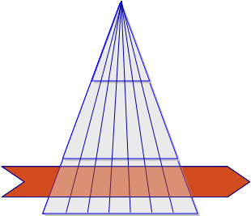
Be aware of the cross-company nature
IAM-Projects touch multiple corpulent functions
Complexity factors
  Identity-Management Processes are typically cross-company.
  There are multiple Stakeholders from different corpulent levels involved in a project.
  3 to 5 mal times higher Communication complexity compared to „normal“ IT-projects.
  Typical Change Management Process
actions
  Strengthen the project management!
  Add an extra reserve for communication!
  Insist on a power sponsor for your project!

Slide 6
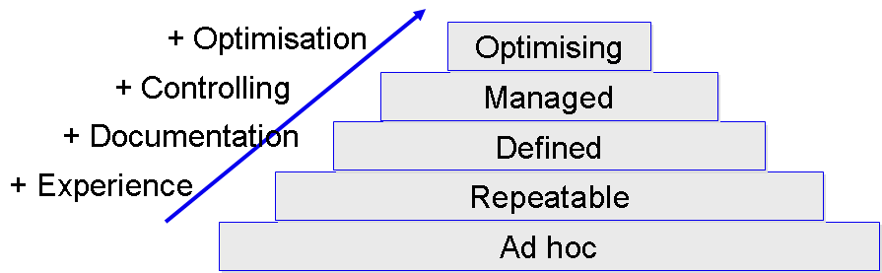
Adapt to your process maturity
There are no islands of order in an ocean of chaos
Complexity factors
  At higher levels of maturity of the management processes (e.g. according to CMMi) the introduction of IAM- processes, -rules, -roles, -policies becomes easier.
  You can’t implement mature IAM-processes in a low maturity process environment.
  The top-down definition of roles needs defined processes.
Actions
  Only launch IAM-projects relying on a maturity level as implemented in the environment.
  Occasionally just say „no”!

Slide 7
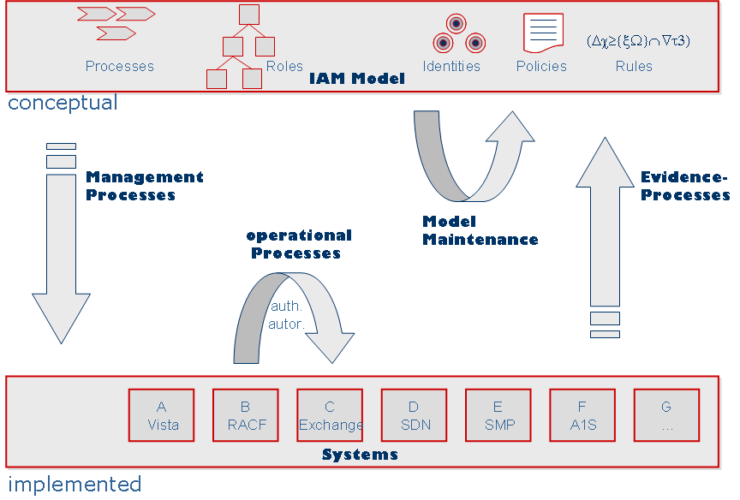
Choose the right project scope
An implementation project cannot reorganise the corporation.
Complexity factors
  Implementation project will have a hard job when having to reorganise the corporation first.
  Model definitions require their own Definition projects before or in parallel to the Implementation.
Actions
  Break your work down into loosely coupled work packages
  Define own projects for the model definition before or in parallel to the Implementation.
  A program made up of several agile projects often is a better solution.
Avoiding the scope trap e.g. for IAM projects

Slide 8

Watch effects of market consolidation
Acquired components don’t necessarily combine to Suites
Complexity factors
  Mergers & Acquisitions often lead to less compatible Product collections.
  The software of acquired companies is often not supported sufficiently.
  It may take a long while, until components fit together as promised.
actions
  Only a Pilot installation under real world conditions leads to the necessary evidence for a product selection.

Slide 9

Ensure availability of domain specialists persons with business domain knowledge are rare creatures
Complexity factors
  The availability of specialists with domain knowledge often turns out to be the bottle neck in role- und process definitions.
  Their involvement is essential for the requirements definition and the QA.
  Waiting times (for specialists) are driving the overall effort.
  While in projects they tend to disappear.
Actions
  Assign the project responsibility to the business departments.
  Think of splitting projects to business definition and an implementation part.

Slide 10
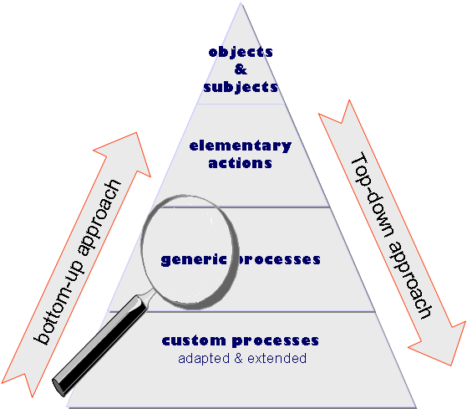

Beware of too deep vertical integration
Don’t try to reinvent the wheel
Complexity factors
  Only a fraction of the overall IAM-Processes is really enterprise specific.
  The adoption of processes and / or Roles from generic Models may speed up projects.
  Not always it is a good idea to start with a blank sheet of paper.
Actions
  Ask your integration partner or consultant for consolidated models containing his experience.
  Participate in Standardisation initiatives (like GenericIAM.org).

Slide 11
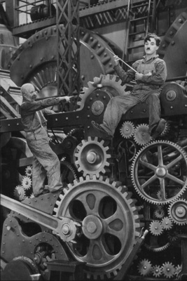
Remember: technical risks still exist
Technology often is more of marketing than reality
Complexity factors
  IAM-SW-Suites are complex and often not easy to handle.
  Without implementation experience in exactly the required environment risk of failure is high.
  „minor“ changes of the version number sometimes cover oft complete new developments.
  The support Matrix of environment components vs. versions often is only sparsely populated.
  Forced replacement of infrastructure components leads to higher effort.
Actions
  Always test selected software in a pilot run before deployment.
  Only choose integration partners with true product experience.

Slide 12
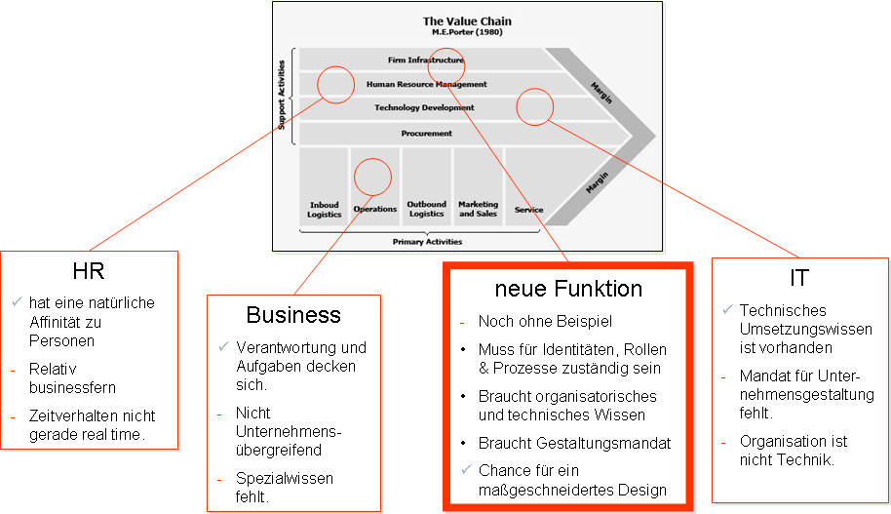
Assign the responsibilities right
IAM is an organisational task & needs a Business Owner
Complexity factors
  Identity Management is a management task.
  Identity Management means organising the enterprise.
  HR could be the natural owner – but often refuses.
  IT has the implementation capabilities but is not mandated to change the organisation.
  On the business side methodological and technical knowledge is lacking.
Actions
  Shift the responsibility to the business side.
  Create a new cross functional group for the operations.

Slide 13
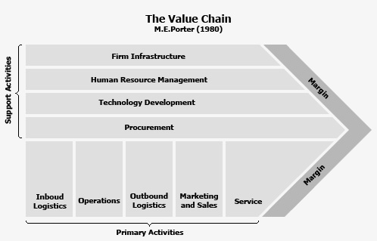
Responsibility
Who should be responsible for the Identity Management?
HR
has a natural relationship to Persons / person data.
Often far from being business minded
HR acts not really “real time”.
IT
Technical implementation skills available
not mandated for organisational changes.
Organisation is not Technology.
new function
Not yet common practice
Must be responsible for Identities, Roles & processes
Needs business organisational and technical skills.
Must be mandated for organisational changes.
Chance for a tailored design
Business
Tasks and responsibility match perfectly.
Doesn’t act enterprise wide
Specific skills are missing.

Slide 14

Global approach adds to complexity
Global projects add to effort and skill requirements.
Regulation may differ by region.
One-size-fits-all might not be the right approach for all subsidiaries.
But the chain may break
at is weakest link.
The responsibility for remote security measures often still stays with the headquarters.
Global PM causes considerable on-top complexity.
Factor-in a 1.5 times higher communication overhead for global projects.
Not all security issues can be handled globally in a uniform way.
Assign regional responsibility – but support them from the headquarters.
Plan for a phased roll-out – a big bang approach rarely works.

Slide 15
Provide for a paying customer often triggered by internal considerations
Often more security does not lead to increase sales.
For infrastructure, awareness or culture it is hard to find an appropriate cost centre.
It is often hard to come-up with a positive business case for investments into IT-security.
As IT Security is often seen as an inhibitor to business there is no credit for taking ownership.
Let risk considerations drive the decision.
Business is about taking risks.
IT security feed into operational and / or reputational risk.
If risk management is not sufficiently rooted within the corporation – insist on C-Level sponsorship.
Establishing a risk culture spread the risk awareness to all corporate levels.

Slide 16
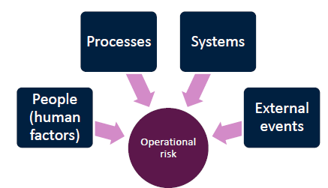
Do the priorities right
You will need drivers from operational risk
Often deadlines are set which cannot be shifted
Even if not – quick success is expected
The size of the task often is overwhelming
Everything seems to equally important
Departments compete for resources to get out of the auditors
focus.
What has to be done 1st?
What may come
later?
It all boils down to risk considerations
Operational & reputational risks
Good enough security = risk based security
Priorities of tasks result from ordering them by their risk.
Caveat: Dept. „risk Management“ quite often is not managing the risks.

Slide 17

Business model / technical Implementation
Process groups emerge naturally from business requirements
Application processes
Authorisation processes
…
Management
processes
Caused by business logic
Caused by physical requirements
Transport processes
Translation processes
Transformation processes
„Provisioning“

Slide 18
The modelling cycle
Note: the direct transition is a short cut to hell
strategy
abstraction
enterprise models
essential
current model
essential
target model
essential
layer
architecture
The enterprise
Modelling cykle
objects
roles
processes
abstraction
projection
“forbidden"
transition
physical
current model
physical
target model
implementation
physical
layer
time
today
tomorrow
classic
systems analysis
technological
progress

Slide 19
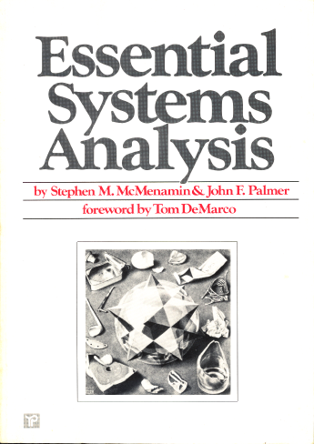
Modelling fundamentals follow the essential systems modelling (esm) principles
The Essential Systems Modelling Methodology was defined and applied by Stephen M. McMenamin and John F. Palmer back in the year 1984.
It was published in a book called essential systems analysis (McMenamin, S. & Palmer, J., Essential Systems Analysis, Yourdon Press Prentice Hall, Englewood Cliffs, NJ, 1984.).

Slide 20
Essential Modelling
Steve McMenamin & John Palmers essential processes
M&P propose an event-oriented approach to process modelling.
To identify the "essential (elementary or atomic) processes" & their relationships to the events that drive the business.
According to M&P essential systems can be detected by the following gedankenexperiment …
  "If we had perfect implementation technology (e.g., a computer with infinite speed, unlimited memory, transparent interface, no failures, and no cost), which of the requirements would still need to be stated?"
  Every requirement that is still necessary in spite perfect technology is an essential requirement.
To remove legacy implementation artifacts from the model in order to prevent them from influencing future models.
Caveat: It turned out, that especially the most experienced practitioners faced difficulties in getting to the next layer of abstraction.

Slide 21
Essential Modelling fundamentals
To the target implementation model in a 4-step Process
Analysis of the current model
    build a model of the actual implementation of the current system.
    This is the physical system like it is implemented in reality - the current physical system.
Include new requirements into the essential model:
    Build the new essential model by adding new requirements.
    This model represents all functional requirements.
    Ideally it is still free of any design- and implementation consideration.
    The result is the new essential system.
Analysis of the fundamental concepts of the current model:
    Deriving of the essence out of the current system.
    All implementation specific artefacts are removed in this step.
    Using "perfect technology" as the guiding principle.
    The result is the current essential system.
Design the new physical model:
    Build the implementation model of the new system.
    The result is the new physical system.
Finding the essence removes implementation artefacts leaving the functional essence.

Slide 22
Representing requirements
The 3rd model represents the functional requirements.
Here the essential business requirements are documented stating what has to be implemented without defining how it will be done.
This separation enables us to implement the same unchanged essential system using different target technologies.
Even when using the same technology maintaining the essential model may turn out to be very helpful.
When significant changed are applied to the essential (=functional) model the optimal new physical model may be implemented by a considerably different design that the current physical model.

Slide 23
Finding the essence
Avoid technical folklore by assuming perfect technology
The assumption of perfect technology leads to the following model characteristics:
Inside the system there are neither errors nor processing or waiting times.
No audit-, translation- or transport processes are necessary.
But the environment of the system is considered as imperfect - as is.
Along the systems boundary a ring of audit-, translation- and transport processes connects to this real world - the physical ring.

Slide 24
Composing the essential system
Essential Processes may be triggered by an external or a time event.
Fundamental essential processes yield an externally useful result.
Administrative essential Processes store their results in essential stores to be used by a fundamental essential process.
Essential Processes are time decoupled, they communicate via essential stores.
Essential processes may be expanded to form nested essential models on a lower layer;
Essential models may be collapsed to serve as essential processes on a higher level.
At the lowest level the essential processes represent elementary activities.
Elementary activities can be found by discovering state transitions of the fundamental (persistent) business objects.
Elementary activities typically bundle all actions, which are done by one processor without a necessary interruption.

Slide 25
Forming processes
Activities are grouped by their business relationship
Business processes behave like travelling guests
they are created by an event,
they are themselves transient objects.
they undergo several state transitions.
they change their state by elementary activities.
they carry along their local knowledge about triggering events, acting processor, affected business objects.
after delivery they terminate their active life by may be archived.

