Slide 1
Identity & Access Governance
What it is, what not and how it changes.
Presented on the 5th annual meeting „Enterprise Identity & Access Management 2016“, 2016-02-18, 09:00
Horst Walther
MD of the SiG Software Integration GmbH
previously: Interim Identity & Access Architect
Deutsche Bank AG

Slide 2
Identity & Access Governance What it is, what not and how it changes
What we are going to talk about? Origin, classification and nature
How do we do it so far? Practice, priorities, status of implementation
What lies ahead? New demands by context, agility, regulations
Where should we rethink? Automation & Analytics (near) real-time
How might it go on? a (still fuzzy) view of the near future

Slide 3
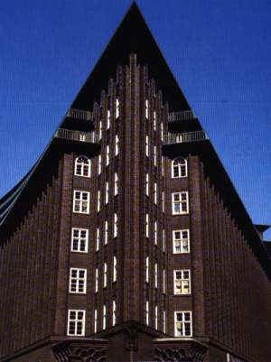
SiG Software Integration GmbH
Founded 1997
Managing Director Dr. Horst Walther
HQ Chilehaus A, Fischertwiete 2, 20095 Hamburg
Contact phone: +49 40 32005 439, fax: +49 40 32005 200, email: horst.walther@si-g.com Focus areas …
Due diligence: audits and assessments to uncover the potential of IT-shops
Strategy: Assessment & creation of Business- & IT-strategies
Implementation:
Interim- & Turnaround Management,
Identity & Access Management and Governance.
Industry sectors
Banks, insurances and other financial institutions, Automotive, chemistry, pharmaceutics, shipping

Slide 4
Identity & Access Governance What it is, what not and how it changes
What we are going to talk about? Origin, classification and nature
How do we do it so far? Practice, priorities, status of implementation
What lies ahead? New demands by context, agility, regulations
Where should we rethink? Automation & Analytics (near) real-time
How might it go on? a (still fuzzy) view of the near future

Slide 5
What is Governance after all? There should be a governance layer on top of each management layer
Some form of ‘governance’, i.e. oversight, strategic change & direction was always expected from high ranking positions like non-executive directors.
The term was coined and defined however during late 20th century only.
It is accepted now that a governance layer resides on top of each management layer.
Governance giving direction & oversight
Management keeping the operations within the defined channel of health
Operations running the business as usual
2015-09-22

Slide 6
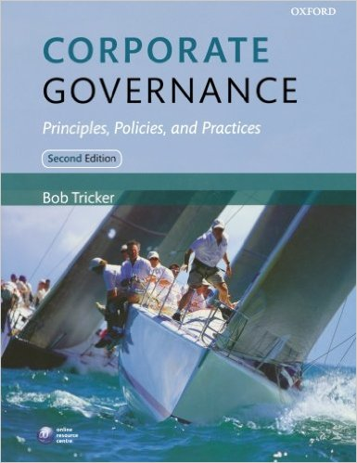
Recommended reading Corporate Governance Principles, Policies and Practices by Bob Tricker
Written by the 'father of corporate governance', this text is an authoritative guide to the frameworks of power that govern organizations.
The third edition covers key developments since the financial crisis, including aggressive tax avoidance, executive pay, and whistle-blowing.
The book is divided into three clear parts that firstly outline the models and principles of governance, before analysing corporate policy, codes, and practice.
International case studies provide real-world examples and a chapter dedicated to global corporate governance illustrates regulation in such diverse regions as Brazil, Russia, the Middle East, and North Africa.

Slide 7
Identity & Access Governance How we discovered the I&A world
Historically we started with the attempt to manage Identity & Access – as it became time to do so.
It turned out not to be an easy task. The questions arose: Are we doing the things right? Are we doing the right things?
Therefore, and as any management layer needs a governance layer on top of it to stay healthy, I&A Governance appeared.
But IAG itself turned out not to be a easy task. The sufficiently powerful equipment for data analytics was missing.
I&A Intelligence was born - the application of data analytics to the domain of Identity & Access .
IAM
IAG
IAI
?
?

Slide 8
Separating into Identity and into Access e.g. IAM = Identity Management (IM) + Access Management (AM)
Identity & Access
Identity
Access
Model & manage the identity's access to corporate resources.
Define the digital identity
and its life cycle

Slide 9
Direction – we need a strategy Strategy development - in the narrow and in the broad definition.
Mission
Current status
Influences & Trends
What are our values?
Where do we stand today?
What developments are on the horizon?
Where do we want to be in ten years?
What we plan for the future?
What prerequisites we have to create?
Who does what and when?
What will it cost?
Scenarios & Vision
Directions & goals
Success factors
Actions
Core strategy
Resources
2016-02-18

Slide 10
Strategy development a cyclic process
abstract
Mission
Scenarios
Vision
Influencing factors
Abstraction
Directions
Goals
Success factors
Strengths & weaknesses
Actions
concrete
Short term
Time horizon
Long term
Strategy development follows a cyclic process
It will transform an organization from a defined here-and-now state in a specific future state.
In between it is deals with abstract and far-off future issues.
2016-02-18

Slide 11
Expressing it as guidance The pyramid of corporate regulations
specifications & work instructions
policies & guidelines
procedures & standards
policies: policies are binding corpulent documents, usually issued by top management. They express goals, principles, focal areas and responsibilities. They represent the top level of the documentation pyramid.
guidelines: guidelines like policies are of a high level of abstraction. However they don’t come with a binding character.
Procedures: Procedures lay out all management controls for a defined problem domain on an essential level. They contain (static) functions & responsibilities and (dynamic) processes.
standards: They state requirements for generic minimums standards, a choice of good practice examples or a bandwidth of tolerable quality parameters.
Specifications: The Implementation of controls on a physical level is specified in operational specifications, work flows, specifications, ... Techniques, configurations of solutions and organisational processes are documented on this level.
Work instructions: Based on the defining procedures work instructions specify the volatile details like configuration parameters or physical techniques.

Slide 12
Executing oversight for I&A Governance Standard implementations of detective controls
As long as I&A process maturity is low – hence preventive controls are weak …
Detective controls dominate the IAG processes.
They should be gradually reduced in favour of preventive controls.
Reconciliation Does the implementation reflect the intended state? Daily health check.
preventive
detective
Attestation Is our intention still valid? Quarterly to biannual check on validity.
corrective
Expiration To limit risks for domains outside your own control.

Slide 13
Identity & Access Governance What it is, what not and how it changes
What we are going to talk about? Origin, classification and nature
How do we do it so far? Practice, priorities, status of implementation
What lies ahead? New demands by context, agility, regulations
Where should we rethink? Automation & Analytics (near) real-time
How might it go on? a (still fuzzy) view of the near future

Slide 14
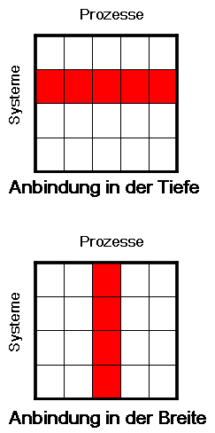
Oversight - only since I&A Governance is defined? Even before there were governance-driven approaches
Governance driven Management driven
Processes
Deep integration of a few …
To connect a few systems completely
The privilege situation is well known
bidirectional connection technically available
Important mass systems:
Windows
Exchange
Lotus NOTES
System launch
Shallow integration of many for evidence ...
To set up a central user administration
If security and compliance considerations are dominate.
If many little known legacy systems are to be connected.
Systems
Deep integration of a few
Processes
Systems
Shallow integration of many
Only the formal definition of governance directs attention to the need for both levels
Notes:
14

Slide 15
Oversight starts with a simple question Who has (had) access to which Resources?
contractors
employees
Did he access after all? Was he authorised?
suppliers
staff
present
customers
Who?
has(had)?
Who has (had) access to which Resources?
Admins
In the past
Things
Systems / APIs
Application
read / write
Middleware
Access?
Is the access authorised?
Operating systems
Resources?
unlimited / limited
Network
privileged
TelCom
Premises

Slide 16
A simple (static) role meta model The separation of functions & constraints pays off even without complex rules
In the (simplest) role meta model …
Roles express the function
Parameters are used as constraints
They combine to several business roles
Business roles are defined in pure business terms
Business roles must be mapped to entitlements.
Entitlements are operations on objects
Business roles may be statically generated.
They may be determined dynamically at run time.
identity
constraint
Business layer
authorisation
business role
functional role
Is assigned 1:n
Technical layer
entitlement
operation
information object

Slide 17
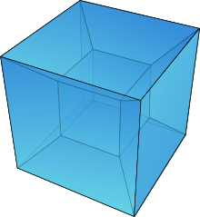
The dimensions of entitlement assignment Access entitlements are not only determined by roles
Dimensions, which determine access …
hierarchy typically the superior has higher entitlements than the subordinate.
function the business function in a corporation.
location access rights often depend from the location.
structure organisational units (OU) differentiate the access rights too,
Cost centre cost centres often don’t match organisational units.
Contract type Aufgrund üblich Mitarbeiter, Vertragspersonal, Berater, Leiharbeiter haben unterschiedliche Ansprüche.
…. And many more …
Tessaract or hypercube: 4-dimensional cube

Slide 18
The 7 commonly used static constraint types But the universe of possible constraints is not limited
Region
Usually the functions to be performed are limited to a region (US, Germany, Brazil, China ...). It may be useful to explicitly state the absence of this restriction by the introduction of a region "world".
Organisational Unit
Often areas of responsibility are separated by the definition of organizational units (OU). It may be useful to make the absence of this restriction explicit by the introduction of the OE "group".
Customer group
The segmentation of the market by customer group (wholesale, retail, corporate customers, dealers …) also leads to constraints to the pure function.
Authority level
In order to control inherent process risks organisations often set "levels of authority". There may be directly applicable limits, which are expressed in currency units or indirectly applicable ones. In the latter case they are expressed in parameters, which in turn can be converted into monetary upper limits, such as mileage allowances, discounts, discretion in the conditions and the like.
Project
If projects may be considered as temporary OUs. Alternatively they represent a separate dimension : project managers and other project roles usually are restricted to particular project and cannot access information objects of other projects.
Object
Sometimes you may be able to restrict entitlements to a defined information object. A tester has to run tests on particular software object (application or system) only; a janitor is responsible just for a particular house.
Contract type
Different entitlements also arise from the contractual agreement a person has with the corporation. Hence the entitlements of permanent employees, interim managers, contractors, consultants and suppliers usually differ considerably.

Slide 19
Degenerations of the Role Meta Model 1. Entitlements not defined in business terms
If not defined in business terms …
the organizational construct to reduce complexity (role) is lacking .
Business responsibles have to deal with technical authorization elements.
a large number of individual decisions becomes necessary.
The risk of errors increases .
The organization can respond to changes only slowly.
identity
Business layer
authorisation
Is assigned 1:n
Technical layer
entitlement
operation
information object

Slide 20
Degenerations of the Role Meta Model 2. No explicitly defined Constraints
Without explicit Constraints …
a role has to be created for each function / parameter combination.
a role inflation is inevitable.
the distinction between Business Role and Functional Role becomes pointless.
Role Selection and Assignment become time consuming.
a large number of individual decisions becomes necessary.
The risk of errors increases .
The organization can respond to changes only slowly.
identity
Business layer
authorisation
business role
functional role
Is assigned 1:n
Technical layer
entitlement
operation
information object

Slide 21
What is RBAC? Expressing the static functional organisation
Role based access control is defined in the US standard ANSI/INCITS 359-2004.
RBAC assumes that permissions needed for an organization’s roles change slowly over time.
But users may enter, leave, and change their roles rapidly.
RBAC meanwhile is a mature and widely used model for controlling information access.
Inheritance mechanisms have been introduced, allowing roles to be structured hierarchically.
Intuitively roles are understood as functions to be performed within a corporation.
They offer a natural approach to express segregation-of-duty requirements.
By their very nature roles are global to a given context.
RBAC requires that roles have a consistent definition across multiple domains.
Distributed role definitions might lead to conflicts.
But not all permission determining dimensions are functional.
What is about location, organisational unit, customer group, cost centre and the like?
Those non-functional ‘attributes’ of the job function may become role parameters.
Parameters – in their simplest form – act as constraints.

Slide 22
Identity & Access Governance What it is, what not and how it changes
What we are going to talk about? Origin, classification and nature
How do we do it so far? Practice, priorities, status of implementation
What lies ahead? New demands by context, agility, regulations
Where should we rethink? Automation & Analytics (near) real-time
How might it go on? a (still fuzzy) view of the near future

Slide 23
Where does agility enter the game? Context comes into play – and requires dynamic constraints
Device
The device in use might limit what someone is allowed to do. Some devices like tablets or smartphones might be considered less secure.
Location
The location the identity is at when performing an action. Mobile, remote use might be considered less secure.
System health status
The current status of a system based on security scans, update status, and other “health” information, reflecting the attack surface and risk.
Authentication strength
The strength, reliability, trustworthiness of authentications. You might require a certain level of authentication strength or apply
Mandatory absence Traders may not be allowed to trade in their vacation. Mandatory time Away (MTA) is used as a detective / preventive control for sensitive business tasks.
More …
constraint
business
rule
context
changes
is used by
Use of dynamic context based constraint types requires policy decision, pull type attribute supply and implemented business rules.

Slide 24
What is ABAC? Attributes + Rules: Replace roles or make it simpler, more flexible
Aimed at higher agility & to avoid role explosions.
Attribute-based access control may replace RBAC or make it simpler and more flexible.
The ABAC model to date is not a rigorously defined approach.
The idea is that access can be determined based on various attributes of a subject.
ABAC can be traced back to A.H. Karp, H. Haury, and M.H. Davis, “From ABAC to ZBAC: the Evolution of Access Control Models,” tech. reportHPL-2009-30, HP Labs, 21 Feb. 2009.
Hereby rules specify conditions under which access is granted or denied.
Example: A bank grants access to a specific system if …
the subject is a teller of a certain OU, working between the hours of 7:30 am and 5:00 pm.
the subject is a supervisor or auditor working at office hours and has management authorization.
This approach at first sight appears more flexible than RBAC.
It does not require separate roles for relevant sets of subject attributes.
Rules can be implemented quickly to accommodate changing needs.
The trade-off is the complexity introduced by the high number of cases.
Providing attributes from various disparate sources adds an additional task.

Slide 25
Combining RBAC and ABAC NIST proposes 3 different way to take advantage of both worlds
Dynamic roles
Attribute-centric
Role-centric
or
or
The “inventors” of RBAC at the NIST recognized the need for a model extension.
Roles already were capable of being parametrized.
Some attributes however are independent of roles
A model was sought to cope with …
Non-functional attributes
Dynamic decisions based on attributes
The NIST came up with a 3-fold proposal

Slide 26
Combining RBAC and ABAC: Dynamic roles NIST proposes 3 different way to take advantage of both worlds
Dynamic roles
Attribute-centric
Role-centric
or
or
Dynamic attributes like time or date are used to determine the subject’s role.
Hereby retaining a conventional role structure but changing role sets dynamically
(R. Fernandez, Enterprise Dynamic Access Control Version 2 Overview, US Space and Naval Warfare Systems Centre, 1 Jan. 2006; http://csrc.nist.gov/rbac/EDACv2overview.pdf).
2 implementation types:
Front-end attribute engine fully determines the user’s role.
Front end only to selects from among a predetermined set of authorized roles.

Slide 27
Combining RBAC and ABAC: Attribute-centric NIST proposes 3 different way to take advantage of both worlds
Dynamic roles
Attribute-centric
Role-centric
or
or
A role name is just one of many attributes – without any fine structure.
The role is not a collection of permissions like in conventional RBAC.
The main drawback is the rapid loss of RBAC’s administrative simplicity as more attributes are added.
(IEEE Computer, vol. 43, no. 6 (June, 2010), pp. 79-81)
ABAC has problems when determining the risk exposure of an employees position.
This 2nd scenario could serve as a good approach for a rapid start.
Generating early results of automatic entitlement assignment - without deep knowledge of the job function.

Slide 28
Combining RBAC and ABAC: Role-centric NIST proposes 3 different way to take advantage of both worlds
Dynamic roles
Attribute-centric
Role-centric
or
or
Attributes are added to constrain RBAC.
Constraints can only reduce permissions available to the user not expand them.
Some of ABAC’s flexibility is lost because access is still granted via a (constrained) role,
System retains the RBAC capability to determine the maximum set of user-obtainable permissions.
The RBAC model in 1992 was explicitly designed, to apply additional constraints to roles.
This approach is the one envisioned as the natural RBAC approach by KuppingerCole.
(https://www.kuppingercole.com/report/enterprise_role_management_done_right).

Slide 29
Agility insertion allows for dynamic authorisation roles and constraints may be created and / or used dynamically
In a dynamic role meta model …
Roles can be created at runtime
So can constraints
They are rule / attribute pairs
Roles & constraints can be deployed dynamically too.
Dynamicity is propagated from constraints an/or from functional roles to business roles and authorisations
Entitlements and identities remain static at the same time.
identity
constraint
{
attribute
rule
rule
authorisation
business role
functional role
{
attribute
rule
rule
Is assigned 1:n
entitlement
operation
information object

Slide 30
Was sagt die Gartner Group dazu?

Slide 31
Identity & Access Governance What it is, what not and how it changes
What we are going to talk about? Origin, classification and nature
How do we do it so far? Practice, priorities, status of implementation
What lies ahead? New demands by context, agility, regulations
Where should we rethink? Automation & Analytics (near) real-time
How might it go on? a (still fuzzy) view of the near future

Slide 32
Governance in a flexible RBAC & ABAC world I How to do recertification if there are no static entitlements?
Don’t leave rules unrelated
Provide a traceable deduction from business- or regulatory requirements:
e.g. Regulations (external) → Policies (internal) → Rules (executable, atomic) → Authorisations (operational)
Attributes must be provided
On demand during call (of authorization sub system)
Centrally by an attribute server (which in turn collects them form various corporate or external sources)
A vendor implementation:
Pre-calculation of authorisations for historical records every 10 minutes
Reporting authorisations in 3 views:
the asset
the individual
the role
Suggested improvements:
Calculation of authorisations on each attribute change event.
The resulting amount of data requires an data oriented architecture.

Slide 33
Governance while granting access dynamically The increased dynamic complicates traditional audit approaches
Policy change log
Machine readable policies
Automated Policies execution.
Policy-changes documented in Change-Logs.
Who had access to what?
Authorization situation traceable
Novel simulation and visualization tools required for auditors.
Access Audit Trail
Every access with its qualifying attributes is recorded
Unsuccessful access attempts with criticality are held.
Who did access when?
Data amounts require data warehouse / Big Data technology
Near-real-time analyses become possible through the use of advanced analytics operational.

Slide 34
Governance in a flexible RBAC & ABAC world II How to do recertification if there are no static entitlements?
However, some limitations may remain …
There is no static answer the who-has-access-to-what question.
There is no way around the enumeration of same rule for reporting & audit, which are used for the authorisation act as well.
Maybe the auditors questions have to be altered & more explicitly specified.
The who-has-access-to-what result is of no value per se.
In the end auditors need to detect rule breaks.
Re-certification of dynamic entitlements will feel more like debugging JavaScript code.

Slide 35
Requirements to I&A technology
IAM, IAG & IAI operate on highly overlapping information.
If different tools are used, the underlying data have to be kept in tight sync.
Single duty services, operating in an SOA environment, are to be preferred over all encompassing monolithic suites.
In attestation runs business line representatives reassess past business decisions.
Information hence needs to be presented to them in business terms.
Information security demands a holistic approach.
Entitlement information and operational access information have to span all relevant layers of the IT stack (apps., OS, HW and – of course – physical access).
For forensic investigations assessments have to be performed back in time
Past entitlement situations hence need to be stored in a normalized structure, reaching sufficiently back and easy to query in its historic context (‚temporal‘ functionality).

Slide 36
Identity & Access Governance What it is, what not and how it changes
What we are going to talk about? Origin, classification and nature
How do we do it so far? Practice, priorities, status of implementation
What lies ahead? New demands by context, agility, regulations
Where should we rethink? Automation & Analytics (near) real-time
How might it go on? a (still fuzzy) view of the near future

Slide 37
How we should set-up the I&A Discovery & warehousing enter centre stage if I&A Governance
Deciding on the implementation of appropriate activities needs a solid foundation.
Data analytics applied to I&A provide the equivalent of switching on the light before cleaning up a mess.
Compilation of the most basic I&A health indicators allows for directing effort in the most promising IAM and / or IAG activities.
IAI should be the first of the three disciplines to invest into.
In addition to I&A knowledge it requires sound data analytics skill – usually not found in I&A but rather in marketing or product-Q&A.
IAI
IAM
IAG

Slide 38
Governance requires a reporting centric architecture
(G) UI
(G) UI
Model maintenance service
Authentication service
Authorisation service
Auditing service
Monitoring service
← Business layer
Directory service
Rule service
Workflow Service
Database service
Event service
← Technical layer
Discovery service
Reporting service
Listening service
ETL service
Optimizing service
← Data layer
Data warehousing service
Identity & Access Governance needs to be built on top of a powerful data warehouse

Slide 39
Outlook Static vs. dynamic approach
Roles augmented by rules / attributes
Reduced role complexity
RBAC complemented by ABAC
Automated access assignment and removal
Policy driven entitlement assignment
Risk driven on-demand re-certification
Real-time analytics
All privilege determining parameters expressed as static roles.
Complex roles
Manual processes
Necessity for management interaction
Recertification campaigns
Easy to re-certify static entitlements

Slide 40
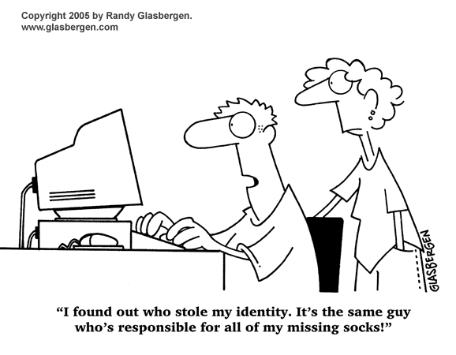
Identity theft
Notes:
40

Slide 41
Questions - comments – suggestions?
Notes:
41

Slide 42
Caution Appendix
Here the notorious back-up-slides follow ...
Notes:
42

Slide 43
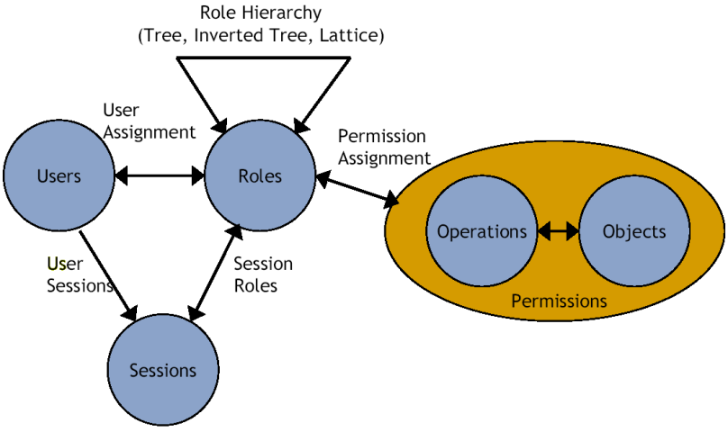
What are roles? (Hierarchical) compositions of functions to pre-built tasks.
local
Roles …
are compositions of functions to pre-built tasks
can be ordered hierarchically.
may be parametrised
may be valid for a session (temporarily).
are assigned to identities
central
Source: Ferraiolo, Sundhu, Gavrila: A Proposed Standard for Role-Based Access Control, 2000.

Slide 44
The (perceived) Evolution of Access control
Increasingly Policy Basis for Access Control Decisions →
?
RdBAC
PBAC
RBAC
ABAC
ACL
Increasingly finer granularity of Access Control →

